Slide 1
John Buczkowski December 29th, 2025
Food Delivery Sentiment Analysis
Generative-AI

Slide 2
Contents / Agenda
Business Context, Problem Overview and Solution Approach
Exploring Different Prompting Techniques
Prompts and the structure of the Prompts
Output from the Prompts
Observations/Insights and conclusions
Appendix

Slide 3
Project Goals and Objectives
Background:
In the food delivery industry, customer feedback drives service quality and brand loyalty. Companies like Uber Eats, DoorDash, and Grubhub rely on reviews to improve operational efficiency and customer satisfaction. With the high volume of reviews posted daily across multiple cities, manual analysis isn't feasible. Reviews in the form of unstructured text contain complaints, praise, and personal experience feedback. They require automated systems that can classify sentiment consistently and without bias.
Goal:
Automate sentiment classification of customer feedback for a food delivery platform using Generative AI and Prompt Engineering. Process customer reviews into Positive, Negative, or Neutral categories while ensuring factual consistency and interpretability. Map outputs with relevant tags (Delivery Time, Food Quality, Price, Packaging, Overall Experience) and suggested business actions.

Slide 4
Project Goals and Objectives
Objectives:
Design structured prompts enabling an LLM to perform sentiment classification on customer feedback
Implement four (4) prompting strategies:
Zero-Shot
Few-Shot
Zero-Shot Chain of Thought (CoT)
Few-Shot CoT
Compare prompting strategies in terms of accuracy, reasoning and contextual understanding
Determine best performing strategy
Generate suggested actions to guide business response, such as flagging delivery issues for operations or highlighting positive reviews for marketing.

Slide 5
Definitions
Zero-Shot Prompt:
Direct instructions with no examples. Model relies on its training to complete the task.
Few-Shot Prompt:
Instructions with 3-5 labeled examples demonstrating the desired input → output pattern.
Zero-Shot Chain of Thought (CoT) Prompt:
Instructions include reasoning steps but no examples. The model reasons through the problem step-by-step before producing output.
Few-Shot Chain of Thought (CoT) Prompt:
Instructions along with examples that show both reasoning and output. Model learns the process through the provided examples.
Ground Truth:
A subset of manually classified reviews (25-36) to serve as the benchmark to measure prompt model results agreement with Ground Truth labels.

Slide 6
Solution Approach
1. Exploratory Data Analysis (EDA)
Understand dataset structure and review content
2. Create Ground Truth
Manually classify 25-36 reviews as benchmark for accuracy measurement
3. Develop Prompt Templates
Zero-Shot
Few-Shot
Zero-Shot CoT
Few-Shot CoT
4. Tune Each Prompt Type
Test variations (temperature, examples, reasoning detail)
Compare results against Ground Truth
Select best-performing version of each type

Slide 7
Solution Approach
5. Compare Across Prompt Types
Evaluate all 4 optimized prompts
Identify top 2 performers
6. Full Dataset Analysis
Run top 2 prompts on complete dataset (100 reviews)
Analyze sentiment distribution, tag frequency
7. Business Insights
Sentiment by City
Delivery Time patterns by sentiment
Additional cross-analysis
8. Conclusions & Recommendations
Summary of findings
Suggested business actions

Slide 8
Expected Outcomes
Prompt Engineering:
Develop optimized prompts for sentiment classification using Zero-Shot, Few-Shot, and CoT
Identify the best-performing prompt type through accuracy comparison
Create reusable prompt templates for future analysis
Sentiment Insights:
Classify customer reviews into Positive, Negative, and Neutral categories
Identify common themes driving negative feedback (delivery delays, food quality, pricing)
Map sentiment patterns across cities and delivery times
Process Improvement:
Reduce manual effort in reviewing customer feedback
Ensure consistent and unbiased sentiment classification
Enable faster identification of issues requiring business attention
Increase Business Value:
Generate actionable insights to relevant teams (operations, marketing, quality)
Prioritize high-impact issues based on sentiment frequency and severity
Increase scalability (process more reviews) while keeping costs low

Slide 9
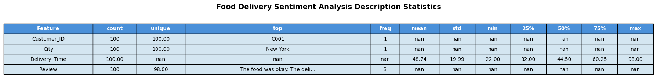
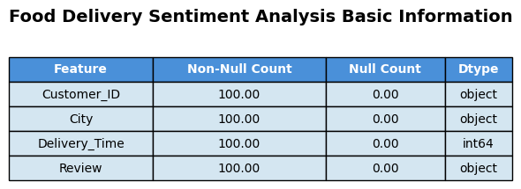
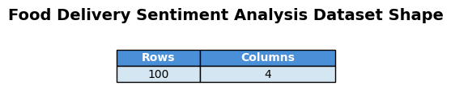
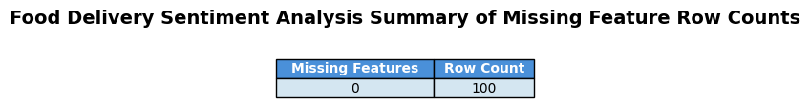
Initial Exploratory Data Analysis (EDA)
Summary statistics for features including count, mean, standard deviation, and distribution percentiles.
Data Shape — 4 columns, 100 rows of data
Missing values — There are no missing values, imputation is not required
High variance — Delivery_Times range from 22 → 98 minutes, with a mean of ≈ 49 minutes
Potential outliers — There do not appear to be any outliers

Slide 10
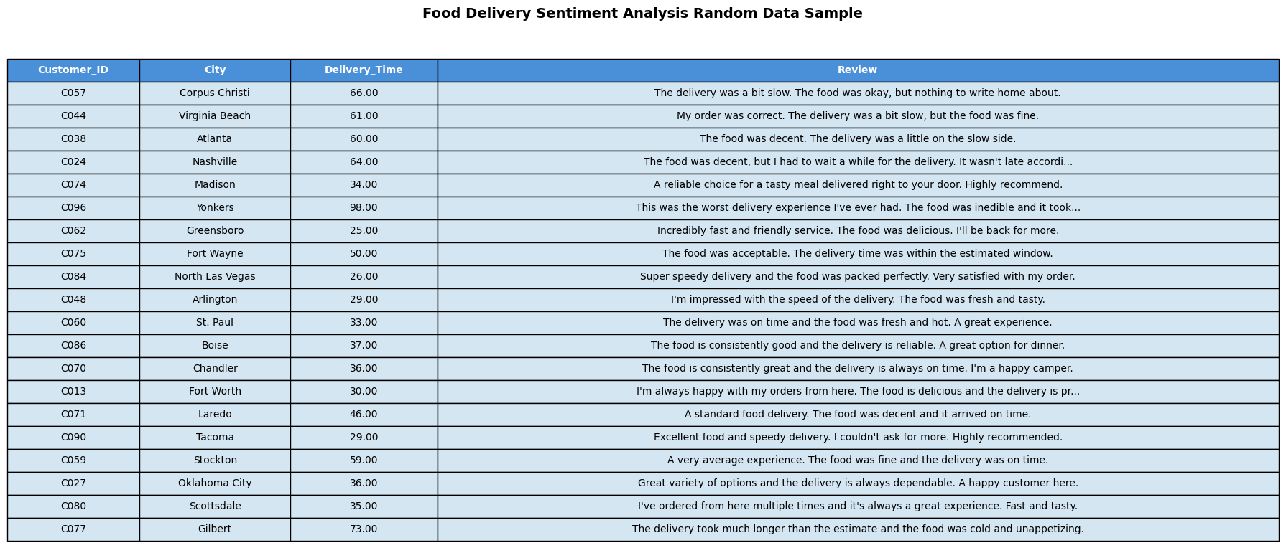
Initial Exploratory Data Analysis (EDA)
Table containing a random sampling of 20 rows from the imported raw dataset.

Slide 11
Ground Truth Dataset
Ground Truth Summary:
Ground Truth (GT) is a subset of the data with manually created verified, correct labels that represent the known right answers. It is used as a benchmark to measure how well the prompts perform. Without it, accuracy, precision, recall, or F1-scores cannot be calculated. For our purposes, we’ll be using the GT for comparison by hand. It should be recognized that since it was created manually, it is subject to human biases.
To create the GT, 36 reviews were selected from the dataset. Each one was examined, then manually classified as Positive, Negative, or Neutral, and assigned appropriate tags. This was saved as the reference dataset. This step must be completed before running any prompts to prevent bias.
To use, each prompt variation was run on the raw version of the rows in the GT. The models’ raw data output was compared against the GT. This technique was used to select the best performer of each prompt type.

Slide 12
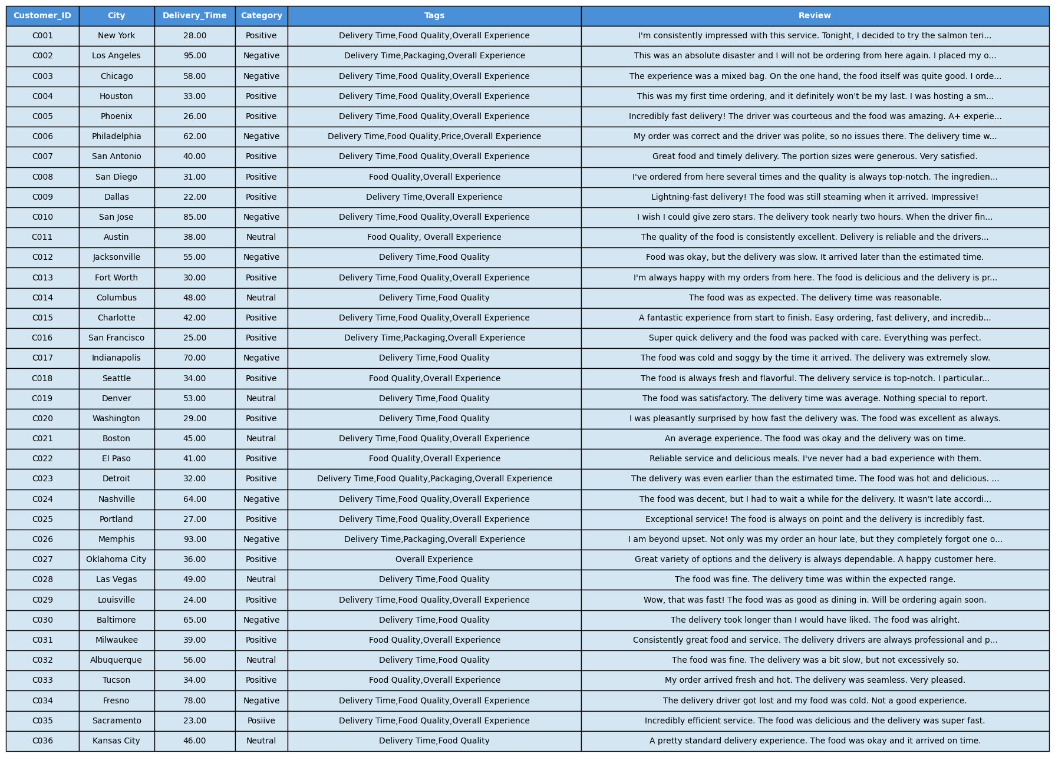
Ground Truth Dataset

Slide 13
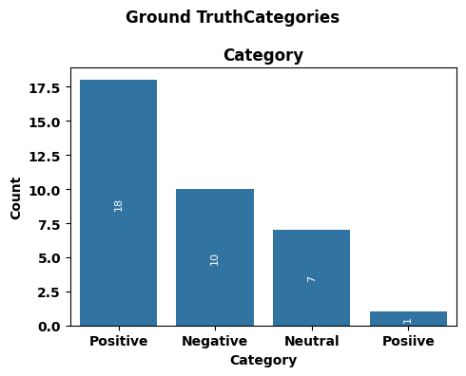
Ground Truth Dataset
Plot illustrating distribution Ground Truth Categories

Slide 14
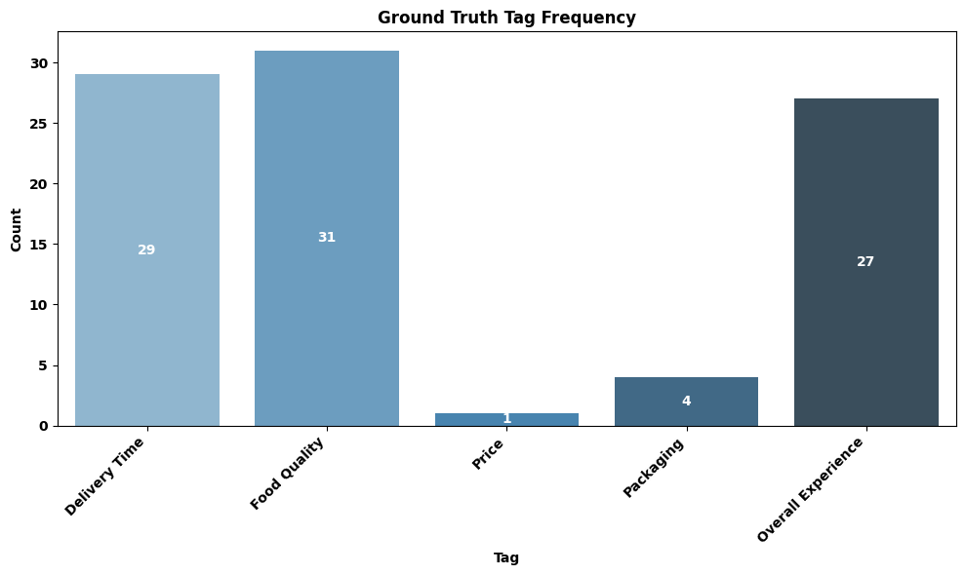
Ground Truth Dataset
Plot illustrating distribution of Tags

Slide 15
Original Zero-Shot Prompt
Original Zero-Shot Prompt Template:
ROLE: You are a customer feedback analyst for a food delivery service.
TASK: Analyze the uploaded customer reviews and provide structured sentiment analysis.
Use Temperature=1
CLASSIFICATION GUIDELINES:
Positive: Customer expresses satisfaction, praise, or intent to return
Negative: Customer expresses dissatisfaction, complaints, or intent to not return
Neutral: Mixed feedback or neither clearly positive nor negative
TAGS (select ALL applicable from this list ONLY):
Delivery Time, Food Quality, Price, Packaging
Overall Experience: only when customer states "experience," "service," or uses general rating language
OUTPUT REQUIREMENTS:
Category: Classify as exactly one of: Positive, Negative, or Neutral
Tags: Select ALL applicable tags from the list above.
Suggested_Action: Provide ONE specific, actionable business recommendation (10 words max)
Confidence: High / Medium / Low
OUTPUT FORMAT: Return results as CSV format only. No explanations, no extra text. Use these exact headers: Customer_ID, Category, Tags, Suggested_Action, Confidence
Rules:
Wrap Tags in quotes if multiple: "Delivery Time, Food Quality"
Wrap Suggested_Action in quotes
Suggested_Action: 10 words max, no commas
One row per customer
Run above Zero-Shot Prompt; Run numeric comparison against Ground Truth Results

Slide 16
Zero-Shot Prompt Definition Explanation
I. Core Purpose
Role:
Frame of Reference provided to the AI
It tells the AI to use the relevant expertise, language, and thought process for that specific job or situation.
Task:
Main instruction telling AI what to do. Core command that defines the objective.
It directs the AI to perform a specific action, like summarizing, classifying, generating, or analyzing.
II. Model Behavior Settings
Temperature: 1 (More diverse/creative output)
III. Analysis Guidelines
Classification (Category):
Overall category to be assigned to each review based on the review’s textual contents
Tags (Select ALL applicable from list ONLY):
Overall Experience: ONLY if customer states "experience," "service," or uses general rating language.
Confidence:
Is the internal assessment of the AI’s confidence in the model prediction (reliability)
IV. Output Structure & Format
Required Fields: Fields to be contained in the result output
Format: What format the output will have (in this case .csv)
CSV Headers: Field/Column headers for the csv output
Specific Rules: Specific rules to be applied to the output.

Slide 17
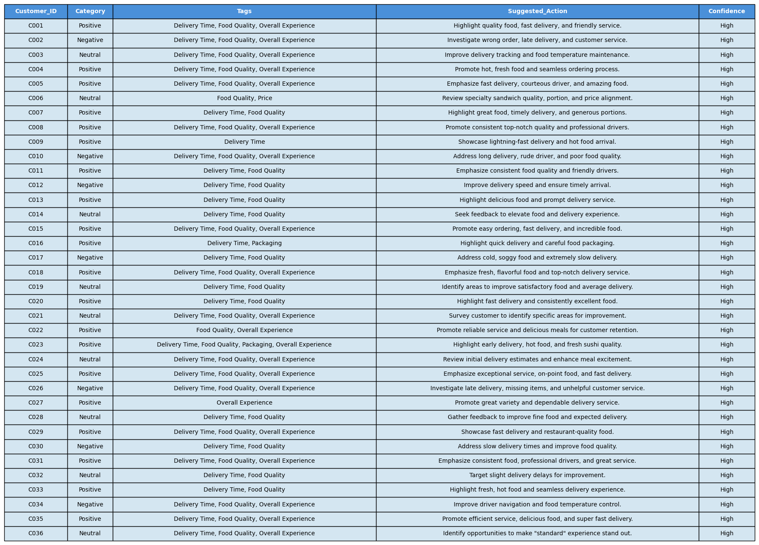
Original Zero-Shot Prompt Results

Slide 18
Original Zero-Shot Prompt Results
Numerical Comparison Summary (Zero-Shot Prompt, Original Tags, T=1 vs. Ground Truth):
1. Category Differences (vs. Ground Truth):
C003: My Neutral vs. GT Negative - 1 difference
C006: My Neutral vs. GT Negative - 1 difference
C011: My Positive vs. GT Neutral - 1 difference
C012: My Negative vs. GT Negative - Match
C024: My Neutral vs. GT Negative - 1 difference
C030: My Negative vs. GT Negative - Match
Total Category Differences: 4
2. Tags Differences (vs. Ground Truth):
C002: My (Food Quality, Overall Experience) vs. GT (Packaging, Overall Experience) - 2 differences
C006: My (no Delivery Time) vs. GT (Delivery Time) - 1 difference
C007: My (no Overall Experience) vs. GT (Overall Experience) - 1 difference
C008: My (Delivery Time) vs. GT (no Delivery Time) - 1 difference
C009: My (no Overall Experience) vs. GT (Overall Experience) - 1 difference
C011: My (Delivery Time, no Overall Experience) vs. GT (no Delivery Time, Overall Experience) - 2 differences
C013: My (no Overall Experience) vs. GT (Overall Experience) - 1 difference
C016: My (no Overall Experience) vs. GT (Overall Experience) - 1 difference
C018: My (Delivery Time) vs. GT (no Delivery Time) - 1 difference
C024: My (no Food Quality) vs. GT (Food Quality) - 1 difference
C026: My (Food Quality, Overall Experience) vs. GT (Packaging, Overall Experience) - 2 differences
C027: My (Delivery Time) vs. GT (no Delivery Time) - 1 difference
C031: My (Delivery Time) vs. GT (no Delivery Time) - 1 difference
C033: My (Delivery Time, no Overall Experience) vs. GT (no Delivery Time, Overall Experience) - 2 differences
C036: My (Overall Experience) vs. GT (no Overall Experience) - 1 difference
Total Tags Differences: 20
3. Total Rows with at least one difference (Category or Tags): 15 out of 36 rows.

Slide 19
Original Zero-Shot Prompt Results
Conclusion:
Zero-Shot prompt with the original settings, performed identically at temperatures = (0, 0.2, and 1).
Category alignment: 4 discrepancies.
Tag alignment: 20 discrepancies.
Total rows with differences: 15.
This consistent performance across various temperatures for the Zero-Shot prompt (without examples) strongly confirms that the model's interpretation of these specific, stricter textual guidelines is the sole determinant of its output in this scenario. The discrepancies are entirely rooted in the prompt's instructions themselves, not in any randomness or variability controlled by temperature.
*** Result analysis and comparisons between prompt and Ground Truth were performed by AI Studio (Gemini)
via the command prompt: “Run numeric comparison against Ground Truth Results”

Slide 20
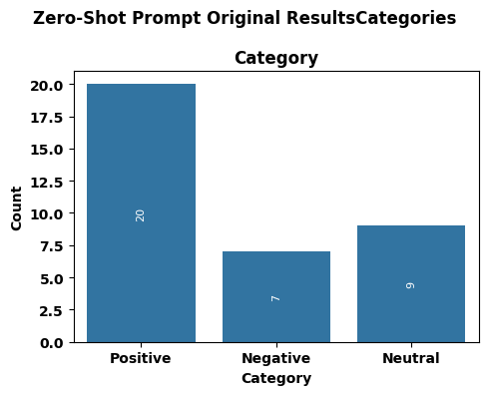
Original Few-Shot Prompt Results
Plot illustrating distribution of Categories

Slide 21
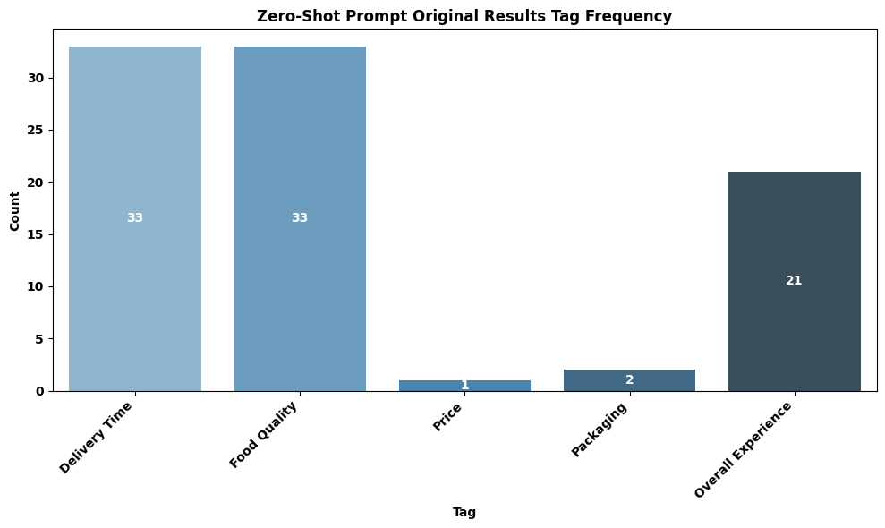
Original Few-Shot Prompt Results
Plot illustrating distribution of Tags

Slide 22
Updated Zero-Shot Prompt
Updated Zero-Shot Prompt Template:
The “Updated Zero-Shot Prompt Template” is based on the original zero prompt with only the following difference:
The Overall Experience tag definition was modified to:
Overall Experience: Apply when the customer explicitly states "experience," "service," "will/won't order again," or uses strong general rating language that clearly reflects their overall sentiment about the entire transaction (e.g., "very satisfied," "impressive," "always happy," "everything was perfect," "very pleased," "loved everything," "terrible meal")

Slide 23
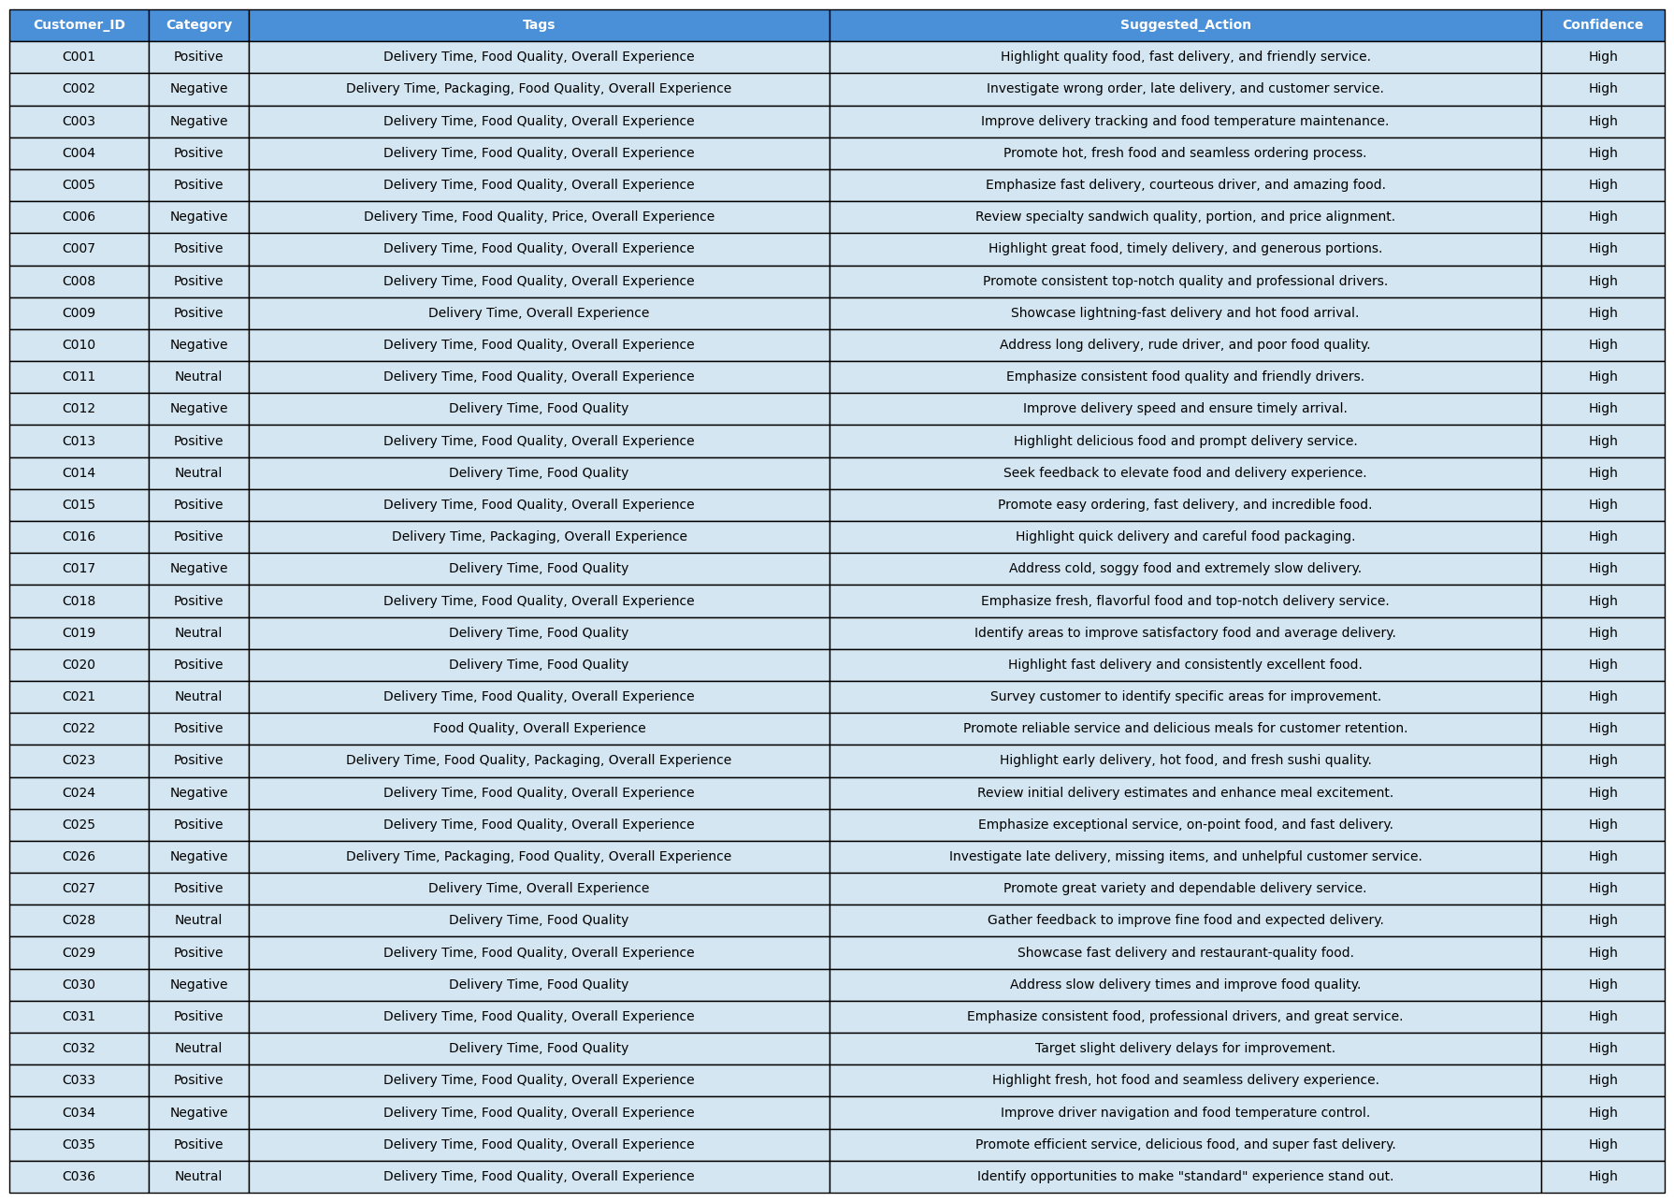
Updated Zero-Shot Prompt Results

Slide 24
Updated Zero-Shot Prompt Results
Numerical Comparison Summary (Zero-Shot Prompt, Updated Overall Experience Tag, T=0.2 vs. Ground Truth):
1. Category Differences (vs. Ground Truth):
Total Tags Differences: 0
2. Tags Differences (vs. Ground Truth):
C002: My (Delivery Time, Packaging, Food Quality, Overall Experience) vs. GT (Delivery Time, Packaging, Overall Experience) - 1 difference (My output has an extra "Food Quality" tag)
C006: My (Delivery Time, Food Quality, Price, Overall Experience) vs. GT (Delivery Time, Food Quality, Price, Overall Experience) - Match
C007: My (Delivery Time, Food Quality, Overall Experience) vs. GT (Delivery Time, Food Quality, Overall Experience) - Match
C00: My (Delivery Time, Food Quality, Overall Experience) vs. GT (Food Quality, Overall Experience) - 1 difference (My output has an extra "Delivery Time" tag)
C009: My (Delivery Time, Overall Experience) vs. GT (Delivery Time, Overall Experience) - Match
C011: My (Delivery Time, Food Quality, Overall Experience) vs. GT (Food Quality, Overall Experience) - 1 difference (My output has an extra "Delivery Time" tag)
C013: My (Delivery Time, Food Quality, Overall Experience) vs. GT (Delivery Time, Food Quality, Overall Experience) - Match
C016: My (Delivery Time, Packaging, Overall Experience) vs. GT (Delivery Time, Packaging, Overall Experience) - Match
C018: My (Delivery Time, Food Quality, Overall Experience) vs. GT (Food Quality, Overall Experience) - 1 difference (My output has an extra "Delivery Time" tag)
C024: My (Delivery Time, Food Quality, Overall Experience) vs. GT (Delivery Time, Food Quality, Overall Experience) - Match
C026: My (Delivery Time, Packaging, Food Quality, Overall Experience) vs. GT (Delivery Time, Packaging, Overall Experience) - 1 difference (My output has an extra "Food Quality" tag)
C027: My (Delivery Time, Overall Experience) vs. GT (Overall Experience) - 1 difference (My output has an extra "Delivery Time" tag)
C031: My (Delivery Time, Food Quality, Overall Experience) vs. GT (Food Quality, Overall Experience) - 1 difference (My output has an extra "Delivery Time" tag)
C033: My (Delivery Time, Food Quality, Overall Experience) vs. GT (Food Quality, Overall Experience) - 1 difference (My output has an extra "Delivery Time" tag)
C036: My (Delivery Time, Food Quality, Overall Experience) vs. GT (Delivery Time, Food Quality) - 1 difference (My output has an extra "Overall Experience" tag)
Total Tags Differences: 10
3. Total Rows with at least one difference (Category or Tags): 8 out of 36 rows.

Slide 25
Updated Zero-Shot Prompt Results
Conclusion:
Updated Zero-Shot prompt with the original settings, performed identically at temperatures = (0, 0.2, and 1).
Category alignment: 0 discrepancies.
Tag alignment: 10 discrepancies.
Total rows with differences: 8.
The refined textual guidelines are highly effective in teaching the model the interpretation for Category classification, achieving perfect alignment. The 10 Tag discrepancies are not due to randomness or temperature variability. This occurs because the model's understanding of specific tag rules (like "Delivery Time" or "Packaging" vs. "Food Quality") doesn't perfectly match the Ground Truth, even with the current instructions.

Slide 26
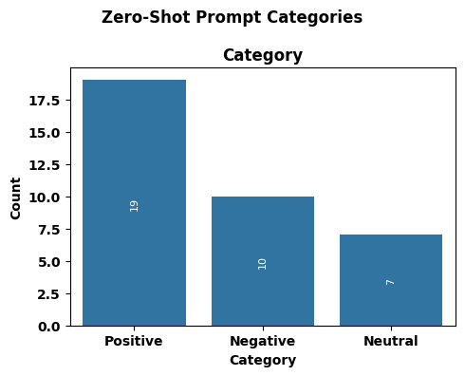
Updated Zero-Shot Prompt Results
Plot illustrating distribution of Categories

Slide 27
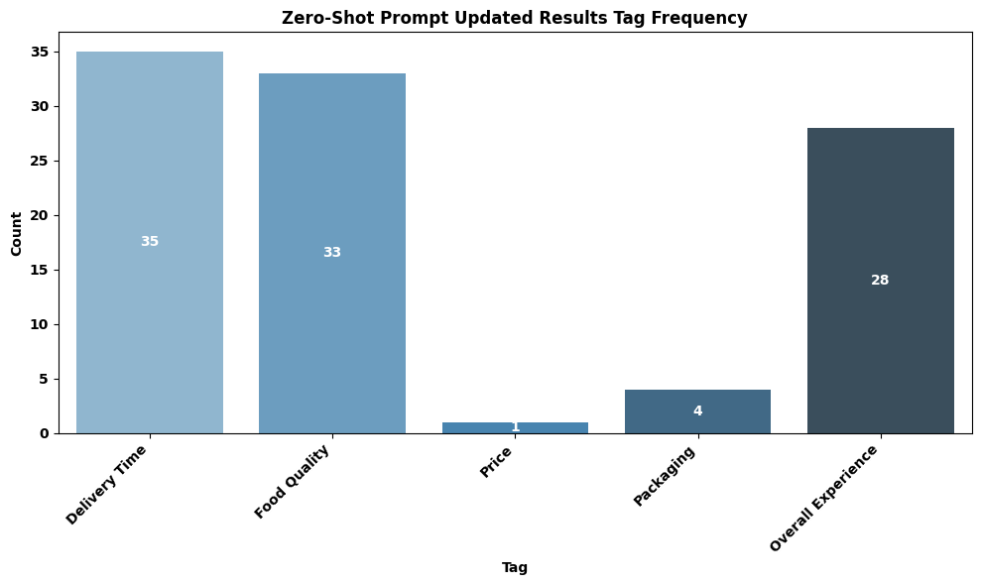
Updated Zero-Shot Prompt Results
Plot illustrating distribution of Tags

Slide 28
Original Few-Shot Prompt
Original Few-Shot Prompt Template:
ROLE: You are a customer feedback analyst for a food delivery service.
TASK: Analyze the uploaded customer reviews and provide structured sentiment analysis.
Use Temperature=0.2
CLASSIFICATION GUIDELINES:
Positive: Customer expresses satisfaction, praise, or intent to return
Negative: Customer expresses dissatisfaction, complaints, or intent to not return
Neutral: Mixed feedback or neither clearly positive nor negative
TAGS (select ALL applicable from this list ONLY):
Delivery Time, Food Quality, Price, Packaging
Overall Experience: only when customer states "experience," "service," or uses general rating language
OUTPUT REQUIREMENTS:
Category: Classify as exactly one of: Positive, Negative, or Neutral
Tags: Select ALL applicable tags from the list above.
Suggested_Action: Provide ONE specific, actionable business recommendation (10 words max)
Confidence: High / Medium / Low
OUTPUT FORMAT: Return results as CSV format only. No explanations, no extra text. Use these exact headers: Customer_ID, Category, Tags, Suggested_Action, Confidence
Rules:
Wrap Tags in quotes if multiple: "Delivery Time, Food Quality"
Wrap Suggested_Action in quotes
Suggested_Action: 10 words max, no commas
One row per customer

Slide 29
Original Few-Shot Prompt
EXAMPLES:
Review: "The food arrived 15 minutes late, which was annoying, but the pad thai was absolutely delicious and still hot. The driver was also very apologetic." Category: Neutral Tags: Delivery Time, Food Quality, Overall Experience Suggested Action: Investigate delivery delay, maintain food quality.
---
Review: "I ordered the large family meal, and the portion sizes were surprisingly small for the price. The chicken was a bit dry, but the sides were fresh. Overall, it felt like a rip-off." Category: Negative Tags: Food Quality, Price, Overall Experience Suggested Action: Review portion sizes and chicken preparation for value.
---
Review: "My smoothie spilled all over the bag because the lid wasn't properly sealed. The delivery was fast, but half my order was a sticky mess. Very disappointed." Category: Negative Tags: Delivery Time, Packaging, Overall Experience Suggested Action: Improve packaging seal quality for liquid items.
---
Review: "The vegetarian burrito was exactly as described and tasted good. Delivery was on time. It was a perfectly fine meal, nothing to rave about." Category: Neutral Tags: Delivery Time, Food Quality Suggested Action: Seek feedback to elevate "fine" to "memorable."
---
Review: "This is my go-to service. The sushi is always fresh, and the drivers are consistently friendly. I've never had a bad experience, which is why I keep coming back."
Category: Positive Tags: Delivery Time, Food Quality, Overall Experience Suggested Action: Highlight consistent quality and reliable service in marketing.
Run above Zero-Shot Prompt; Run numeric comparison against Ground Truth Results

Slide 30
Original Few-Shot Prompt Results

Slide 31
Original Few-Shot Prompt Results
Numerical Comparison Summary (Zero-Shot Prompt, Original Tags, T=0.2 vs. Ground Truth):
1. Category Differences (vs. Ground Truth):
Total Category Differences: 0
2. Tags Differences (vs. Ground Truth):
C002: My (Delivery Time, Packaging, Food Quality, Overall Experience) vs. GT (Delivery Time, Packaging, Overall Experience) - 1 difference (My output has an extra "Food Quality" tag)
C006: My (Delivery Time, Food Quality, Price, Overall Experience) vs. GT (Delivery Time, Food Quality, Price, Overall Experience) - Match
C007: My (Delivery Time, Food Quality, Overall Experience) vs. GT (Delivery Time, Food Quality, Overall Experience) - Match
C008: My (Delivery Time, Food Quality, Overall Experience) vs. GT (Food Quality, Overall Experience) - 1 difference (My output has an extra "Delivery Time" tag)
C009: My (Delivery Time, Overall Experience) vs. GT (Delivery Time, Overall Experience) - Match
C011: My (Delivery Time, Food Quality, Overall Experience) vs. GT (Food Quality, Overall Experience) - 1 difference (My output has an extra "Delivery Time" tag)
C013: My (Delivery Time, Food Quality, Overall Experience) vs. GT (Delivery Time, Food Quality, Overall Experience) - Match
C016: My (Delivery Time, Packaging, Overall Experience) vs. GT (Delivery Time, Packaging, Overall Experience) - Match
C018: My (Delivery Time, Food Quality, Overall Experience) vs. GT (Food Quality, Overall Experience) - 1 difference (My output has an extra "Delivery Time" tag)
C024: My (Delivery Time, Food Quality, Overall Experience) vs. GT (Delivery Time, Food Quality, Overall Experience) - Match
C026: My (Delivery Time, Packaging, Food Quality, Overall Experience) vs. GT (Delivery Time, Packaging, Overall Experience) - 1 difference (My output has an extra "Food Quality" tag)
C027: My (Delivery Time, Overall Experience) vs. GT (Overall Experience) - 1 difference (My output has an extra "Delivery Time" tag)
C031: My (Delivery Time, Food Quality, Overall Experience) vs. GT (Food Quality, Overall Experience) - 1 difference (My output has an extra "Delivery Time" tag)
C033: My (Delivery Time, Food Quality, Overall Experience) vs. GT (Food Quality, Overall Experience) - 1 difference (My output has an extra "Delivery Time" tag)
C036: My (Delivery Time, Food Quality, Overall Experience) vs. GT (Delivery Time, Food Quality) - 1 difference (My output has an extra "Overall Experience" tag)
Total Tags Differences: 10
3. Total Rows with at least one difference (Category or Tags): 8 out of 36 rows.

Slide 32
Original Few-Shot Prompt Results
Conclusion:
Few-Shot prompt with the original definition settings, performed identically at temperatures = (0, 0.2, and 1).
Category alignment: 0 discrepancies.
Tag alignment: 10 discrepancies.
Total rows with differences: 8.
The 5 custom examples are highly effective in teaching the model the interpretation for Category classification, achieving perfect alignment. This consistent performance across various temperatures for the Few-Shot prompt (without examples) strongly confirms that the model's interpretation of these specific, stricter textual guidelines is the sole determinant of its output in this scenario. The Tag discrepancies are entirely rooted in the prompt's instructions themselves, not in any randomness or variability controlled by temperature.

Slide 33
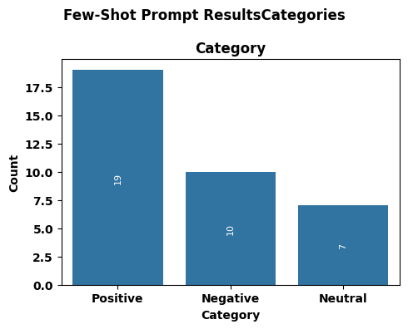
Original Few-Shot Prompt Results
Plot illustrating distribution of Categories

Slide 34
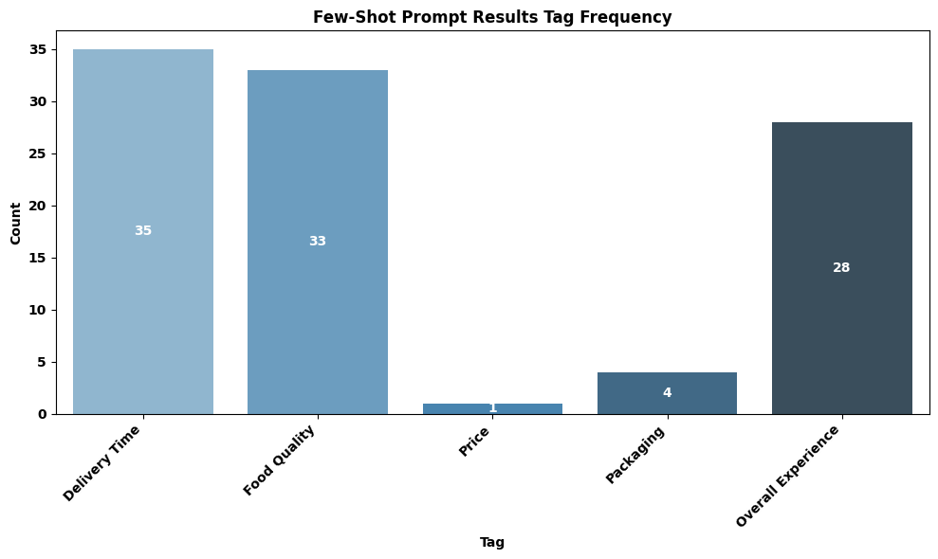
Original Few-Shot Prompt Results
Plot illustrating distribution of Tags

Slide 35
Updated Few-Shot Prompt
Updated Few-Shot Prompt Template:
ROLE: You are a customer feedback analyst for a food delivery service.
TASK: Analyze the uploaded customer reviews and provide structured sentiment analysis.
Use Temperature=0.2
CLASSIFICATION GUIDELINES:
Positive: Customer expresses satisfaction, praise, or intent to return
Negative: Customer expresses dissatisfaction, complaints, or intent to not return. If a review contains both positive/neutral and significant negative feedback (e.g., major delays, cold food, wrong order, poor value for money), classify as Negative.
Neutral: Mixed feedback where positive and negative aspects are balanced, or neither clearly positive nor negative.
TAGS (select ALL applicable from this list ONLY):
Delivery Time
Food Quality: Includes taste, temperature (if affecting quality), freshness, accuracy of order content (e.g., wrong dish, missing items).
Price
Packaging: Includes physical integrity of packaging, spillage, or incorrect items due to packing error.
Overall Experience: Apply when the customer explicitly states "experience," "service," "will/won't order again," or uses strong general rating language that clearly reflects their overall sentiment about the entire transaction (e.g., "very satisfied," "impressive," "always happy," "everything was perfect," "very pleased," "loved everything," "terrible meal").
***** Highlighted text indicates differences from Original Few-Shot Prompt

Slide 36
Updated Few-Shot Prompt
OUTPUT REQUIREMENTS:
Category: Classify as exactly one of: Positive, Negative, or Neutral
Tags: Select ALL applicable tags from the list above.
Suggested_Action: Provide ONE specific, actionable business recommendation (10 words max)
Confidence: High / Medium / Low
OUTPUT FORMAT: Return results as CSV format only. No explanations, no extra text. Use these exact headers: Customer_ID, Category, Tags, Suggested_Action, Confidence
Rules:
Wrap Tags in quotes if multiple: "Delivery Time, Food Quality"
Wrap Suggested_Action in quotes
Suggested_Action: 10 words max, no commas
One row per customer
****** Use same examples from Original Few-Shot Prompt

Slide 37
Updated Few-Shot Prompt Results

Slide 38
Updated Few-Shot Prompt Results
Numerical Comparison Summary (Updated Few-Shot Prompt, Original Tags, T=0.2 vs. Ground Truth):
1. Category Differences (vs. Ground Truth):
Total Category Differences: 0
2. Tags Differences (vs. Ground Truth):
Total Tags Differences: 0
3. Total Rows with at least one difference (Category or Tags): 0 out of 36 rows.
Conclusion:
This confirms that the combination of:
1. Highly refined and explicit textual guidelines for classification and tags.
2. A well-chosen set of 5 custom few-shot examples that illustrate these rules.
3. A deterministic temperature setting (temperature=0.0).
...is extremely effective in teaching the model your precise annotation logic and achieving perfect alignment on this test dataset.
Possible Concerns:
It is quite possible that the prompt has been too highly tuned to the Ground Truth and is overfitted. This would result in misclassification errors for “Category” and “Tags” when the model is run against the entire dataset. Results will have be reviewed (spot checked) by hand for classification accuracy.

Slide 39
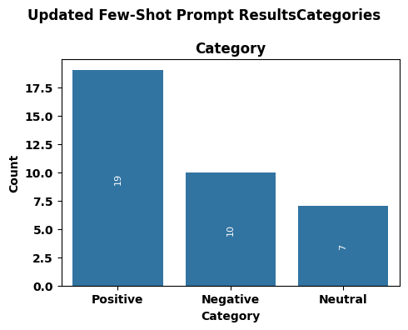
Updated Few-Shot Prompt Results
Plot illustrating distribution of Categories

Slide 40
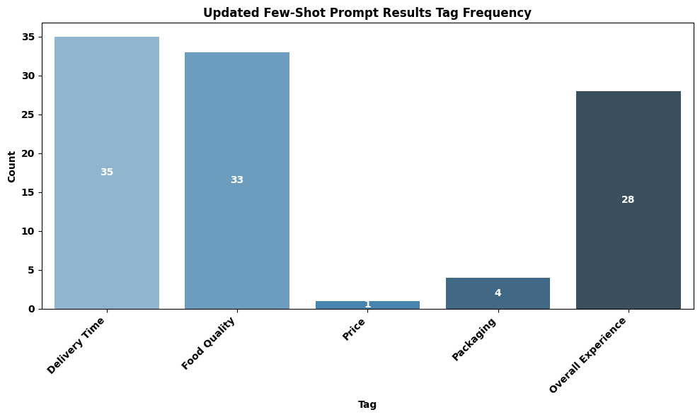
Updated Few-Shot Prompt Results
Plot illustrating distribution of Tags

Slide 41
Original Zero-Shot Chain of Thought (CoT) Prompt
Original Zero-Shot CoT Prompt Template:
ROLE: You are a customer feedback analyst for a food delivery service.
TASK: Analyze the uploaded customer reviews and provide structured sentiment analysis.
Use Temperature=0.2
REASONING STEPS (follow for each review):
1. Identify positive aspects mentioned
2. Identify negative aspects mentioned
3. Determine which dominates or if balanced
4. Select applicable tags
5. Provide classification and output
CLASSIFICATION GUIDELINES:
Positive: Customer expresses satisfaction, praise, or intent to return
Negative: Customer expresses dissatisfaction, complaints, or intent to not return
Neutral: Mixed feedback or neither clearly positive nor negative
TAGS (select ALL applicable from this list ONLY):
Delivery Time
Food Quality
Price
Packaging
Overall Experience: only when customer states "experience," "service," or uses general rating language

Slide 42
Original Zero-Shot Chain of Thought (CoT) Prompt
OUTPUT REQUIREMENTS:
1. Category: Classify as exactly one of: Positive, Negative, or Neutral
2. Tags: Select ALL applicable tags from the list above.
3. Suggested_Action: Provide ONE specific, actionable business recommendation (10 words max)
4. Confidence: High / Medium / Low
OUTPUT FORMAT: Return results as CSV format only. No explanations, no extra text. Use these exact headers: Customer_ID, Category, Tags, Suggested_Action, Confidence
Rules:
Wrap Tags in quotes
Wrap Suggested_Action in quotes
Suggested_Action: 10 words max, no commas
One row per customer
Run above Zero-Shot CoT Prompt Run numeric comparison against Ground Truth Results

Slide 43
Original Zero-Shot CoT Prompt Reasoning Details
Showing reasoning details for a Chain of Thought (CoT) prompt helps understand how the AI reached its answer. By seeing if it followed the defined steps correctly, it is key for fixing any mistakes in its logic or your instructions. This transparency builds trust and makes it easier to improve the prompt, ensuring the AI thinks the way you want it to.
Customer ID: C001 • Positive aspects: Consistently impressed, fantastic choice (salmon teriyaki), fish cooked to perfection (flaky, moist), rich teriyaki glaze (not overly sweet), crisp and fresh steamed vegetables, fast delivery (under 30 mins vs 40 min estimate), friendly driver, followed delivery instructions, refreshing reliable option, high-quality meal. • Negative aspects: None • Dominant: Positive • Tags selected: * Delivery Time: Explicitly mentioned "delivery speed" and "arrived in just under 30" minutes. * Food Quality: Detailed praise for "salmon teriyaki," "fish cooked to perfection," "teriyaki glaze," and "steamed vegetables." * Overall Experience: Customer states "consistently impressed with this service" and "refreshing to have a reliable option for a high-quality meal." • Final Category: Positive • Final Confidence: High • Final Suggested Action: "Maintain high standards for food quality and delivery speed“

Slide 44
Original Zero-Shot CoT Prompt Reasoning Details
Customer ID: C002 • Positive aspects: None • Negative aspects: Absolute disaster, will not be ordering again, order over an hour late (arrived 8:15 PM vs 7:00 PM scheduled), sent completely wrong order (sushi instead of tacos), nightmare with customer service (long holds, unhelpful agents), terrible experience. • Dominant: Negative • Tags selected: * Delivery Time: Explicitly states "over an hour late" and details the delay. * Food Quality: Implied negative as the "completely wrong order" was received, meaning the desired food quality was not experienced. * Overall Experience: Customer states "absolute disaster," "will not be ordering from here again," and "truly terrible experience." • Final Category: Negative • Final Confidence: High • Final Suggested Action: "Address late deliveries, wrong orders, and poor customer service“
Customer ID: C003 • Positive aspects: Food itself was quite good, sauce was creamy and flavorful (chicken fettuccine alfredo). • Negative aspects: Delivery less than ideal, app tracker showed driver making multiple stops, delivery took 20 minutes longer than latest estimated time, pasta was lukewarm, had to be reheated, bit of a letdown. • Dominant: Balanced (good food, but significant delivery issues impacting enjoyment) • Tags selected: * Delivery Time: Explicitly mentions "delivery aspect was less than ideal," "took about 20 minutes longer," and "by the time it arrived." * Food Quality: Mentions "pasta was lukewarm and had to be reheated," directly impacting the quality of the food upon arrival. • Final Category: Neutral • Final Confidence: High • Final Suggested Action: "Optimize delivery routes to ensure timely and hot food"

Slide 45
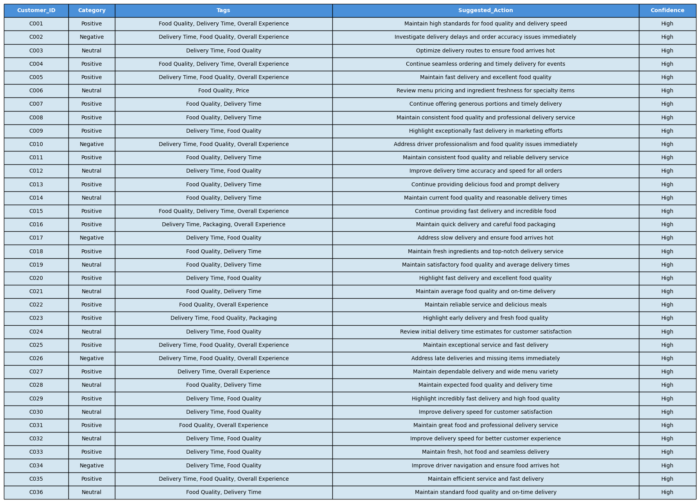
Original Zero-Shot CoT Prompt Results

Slide 46
Original Zero-Shot CoT Prompt Results
Numerical Comparison Summary (Updated Few-Shot Prompt, Original Tags, T=1.0 vs. Ground Truth):
1. Category Differences (vs. Ground Truth):
C003: My Neutral vs. GT Negative - 1 difference
C006: My Neutral vs. GT Negative - 1 difference
C011: My Positive vs. GT Neutral - 1 difference
C024: My Neutral vs. GT Negative - 1 difference
Total Category Differences: 4
2. Tags Differences (vs. Ground Truth):
C002: My (Food Quality, Overall Experience) vs. GT (Packaging, Overall Experience) - 2 differences
C006: My (no Delivery Time) vs. GT (Delivery Time) - 1 difference C007: My (no Overall Experience) vs. GT (Overall Experience) - 1 difference
C008: My (Delivery Time) vs. GT (no Delivery Time) - 1 difference
C009: My (no Overall Experience) vs. GT (Overall Experience) - 1 difference
C011: My (Delivery Time, no Overall Experience) vs. GT (no Delivery Time, Overall Experience) - 2 differences
C013: My (no Overall Experience) vs. GT (Overall Experience) - 1 difference
C016: My (no Overall Experience) vs. GT (Overall Experience) - 1 difference
C018: My (Delivery Time) vs. GT (no Delivery Time) - 1 difference
C024: My (no Food Quality) vs. GT (Food Quality) - 1 difference
C026: My (Food Quality, Overall Experience) vs. GT (Packaging, Overall Experience) - 2 differences
C027: My (Delivery Time) vs. GT (no Delivery Time) - 1 difference
C031: My (Delivery Time) vs. GT (no Delivery Time) - 1 difference
C033: My (Delivery Time, no Overall Experience) vs. GT (no Delivery Time, Overall Experience) - 2 differences
C036: My (Overall Experience) vs. GT (no Overall Experience) - 1 difference
Total Tags Differences: 20
3. Total Rows with at least one difference (Category or Tags): 15 out of 36 rows.

Slide 47
Original Zero-Shot CoT Prompt Results
Conclusion:
Zero-Shot CoT prompt with temperature=1 performed identically to the previous Zero-Shot prompt runs
Category alignment: 4 discrepancies.
Tag alignment: 20 discrepancies.
Total rows with differences: 15.
This Zero-Shot CoT analysis, consistent with other Zero-Shot attempts, confirms that explicit, refined textual guidelines and few-shot examples are crucial for achieving high alignment with specific annotation logic.
Subsequent runs with tighter Temperature settings produced the same results.
Seeing Strange Results – rerunning same prompt with same input data, temperature and commands does not produce consistent results across runs.

Slide 48
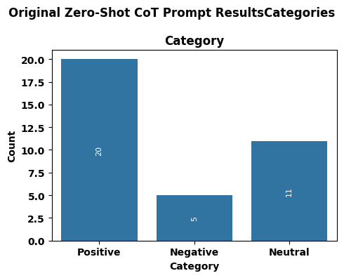
Original Zero-Shot CoT Prompt Results
Plot illustrating distribution of Categories

Slide 49
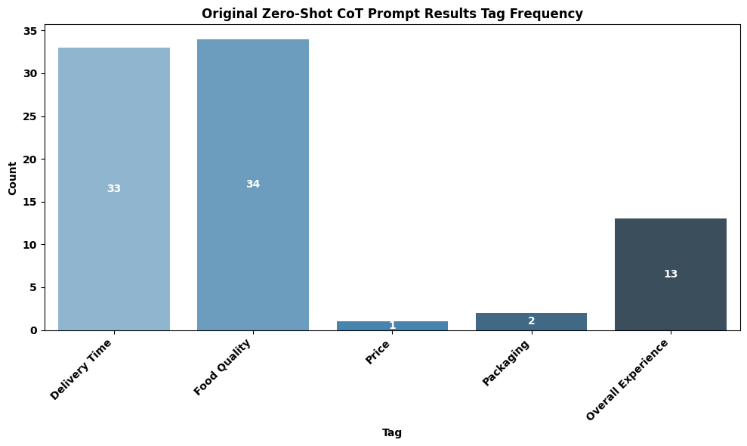
Original Zero-Shot CoT Prompt Results
Plot illustrating distribution of Tags

Slide 50
Few-Shot Chain of Thought (CoT) Prompt
Original Few-Shot CoT Prompt Template:
ROLE: You are a customer feedback analyst for a food delivery service.
TASK: Analyze the uploaded customer reviews and provide structured sentiment analysis.
Use Temperature=0.2
REASONING STEPS (follow for each review):
1. Identify positive aspects mentioned
2. Identify negative aspects mentioned
3. Determine which dominates or if balanced
4. Select applicable tags
5. Provide classification and output
CLASSIFICATION GUIDELINES:
Positive: Customer expresses satisfaction, praise, or intent to return
Negative: Customer expresses dissatisfaction, complaints, or intent to not return
Neutral: Mixed feedback or neither clearly positive nor negative
TAGS (select ALL applicable from this list ONLY):
Delivery Time
Food Quality
Price
Packaging
Overall Experience: only when customer states "experience," "service," or uses general rating language

Slide 51
Few-Shot Chain of Thought (CoT) Prompt
OUTPUT REQUIREMENTS:
1. Category: Classify as exactly one of: Positive, Negative, or Neutral
2. Tags: Select ALL applicable tags from the list above.
3. Suggested_Action: Provide ONE specific, actionable business recommendation (10 words max)
4. Confidence: High / Medium / Low
OUTPUT FORMAT: Return results as CSV format only. No explanations, no extra text. Use these exact headers: Customer_ID, Category, Tags, Suggested_Action, Confidence
Rules:
Wrap Tags in quotes
Wrap Suggested_Action in quotes
Suggested_Action: 10 words max, no commas
One row per customer

Slide 52
Few-Shot Chain of Thought (CoT) Prompt
EXAMPLES:
Review: "The food arrived 15 minutes late, which was annoying, but the pad thai was absolutely delicious and still hot. The driver was also very apologetic.“
Reasoning:
Identify positive aspects mentioned: Pad thai was absolutely delicious and still hot (Food Quality). Driver was very apologetic (Overall Experience).
Identify negative aspects mentioned: Food arrived 15 minutes late (Delivery Time), which was annoying (Overall Experience).
Determine which dominates or if balanced: Mixed feedback. Delicious hot food balances the late delivery. The annoyance is mitigated by the apology. Balanced.
Select applicable tags: "15 minutes late" -> Delivery Time. "absolutely delicious and still hot" -> Food Quality. "annoying" and "apologetic" contribute to the general impression, so Overall Experience.
Provide classification and output: Based on balanced aspects, classify as Neutral. Category: Neutral Confidence: Medium Tags: Delivery Time, Food Quality, Overall Experience Suggested Action: Investigate delivery delay, maintain food quality.
---
Review: "I ordered the large family meal, and the portion sizes were surprisingly small for the price. The chicken was a bit dry, but the sides were fresh. Overall, it felt like a rip-off." Reasoning:
Identify positive aspects mentioned: Sides were fresh (Food Quality).
Identify negative aspects mentioned: Portion sizes were surprisingly small for the price (Price, Food Quality/Value). Chicken was a bit dry (Food Quality). Felt like a rip-off (Price, Overall Experience).
Determine which dominates or if balanced: Significant negative aspects (price, portion size, dry chicken, rip-off feeling) clearly dominate the single positive (fresh sides).
Select applicable tags: "surprisingly small for the price" and "rip-off" -> Price. "chicken was a bit dry" -> Food Quality. "rip-off" -> Overall Experience.
Provide classification and output: Based on dominant negative aspects, classify as Negative. Category: Negative Confidence: High Tags: Food Quality, Price, Overall Experience Suggested Action: Review portion sizes and chicken preparation for value.
---

Slide 53
Few-Shot Chain of Thought (CoT) Prompt
Review: "My smoothie spilled all over the bag because the lid wasn't properly sealed. The delivery was fast, but half my order was a sticky mess. Very disappointed." Reasoning:
Identify positive aspects mentioned: Delivery was fast (Delivery Time).
Identify negative aspects mentioned: Smoothie spilled all over the bag (Packaging), lid wasn't properly sealed (Packaging), sticky mess (Packaging), very disappointed (Overall Experience).
Determine which dominates or if balanced: The significant negative impact of spillage and disappointment clearly dominates the fast delivery.
Select applicable tags: "spilled all over the bag", "lid wasn't properly sealed", "sticky mess" -> Packaging. "delivery was fast" -> Delivery Time. "Very disappointed" -> Overall Experience.
Provide classification and output: Based on dominant negative aspects, classify as Negative. Category: Negative Confidence: High Tags: Delivery Time, Packaging, Overall Experience Suggested Action: Improve packaging seal quality for liquid items.
---
Review: "The vegetarian burrito was exactly as described and tasted good. Delivery was on time. It was a perfectly fine meal, nothing to rave about." Reasoning:
Identify positive aspects mentioned: Exactly as described, tasted good (Food Quality). Delivery was on time (Delivery Time).
Identify negative aspects mentioned: Nothing to rave about (Neutral/Slightly negative nuance).
Determine which dominates or if balanced: All aspects are positive or neutral, but without strong enthusiasm. Balanced.
Select applicable tags: "tasted good" -> Food Quality. "Delivery was on time" -> Delivery Time. "perfectly fine meal, nothing to rave about" does not explicitly state "experience" or "service" and is not strong general rating language, so no Overall Experience.
Provide classification and output: Based on balanced, non-enthusiastic aspects, classify as Neutral. Category: Neutral Confidence: Medium Tags: Delivery Time, Food Quality Suggested Action: Seek feedback to elevate "fine" to "memorable."
---

Slide 54
Few-Shot Chain of Thought (CoT) Prompt
Review: "This is my go-to service. The sushi is always fresh, and the drivers are consistently friendly. I've never had a bad experience, which is why I keep coming back." Reasoning:
Identify positive aspects mentioned: Go-to service (Overall Experience), sushi is always fresh (Food Quality), drivers are consistently friendly (Delivery Time/Overall Experience), never had a bad experience (Overall Experience), keep coming back (Overall Experience).
Identify negative aspects mentioned: None.
Determine which dominates or if balanced: Overwhelmingly positive sentiment and clear intent to return. Dominant Positive.
Select applicable tags: "always fresh" -> Food Quality. "drivers are consistently friendly" -> Delivery Time. "go-to service", "never had a bad experience", "keep coming back" -> Overall Experience.
Provide classification and output: Based on dominant positive aspects, classify as Positive. Category: Positive Confidence: High Tags: Delivery Time, Food Quality, Overall Experience Suggested Action: Highlight consistent quality and reliable service in marketing.
Run above Few-Shot CoT Prompt Run numeric comparison against Ground Truth Results

Slide 55
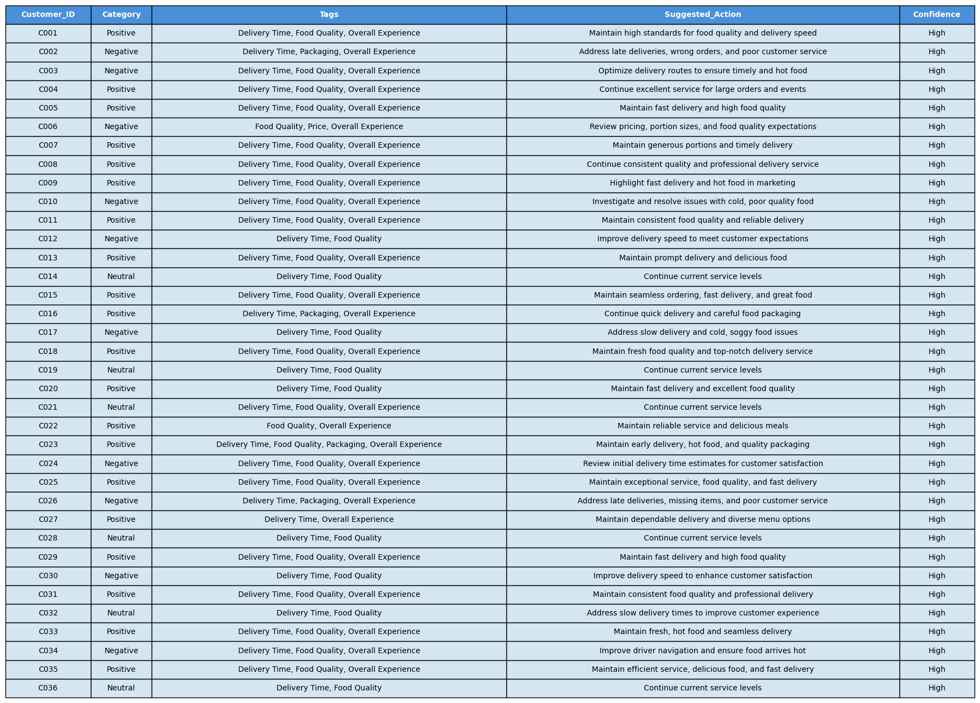
Few-Shot CoT Prompt Results

Slide 56
Few-Shot CoT Prompt Results
Numerical Comparison Summary (Updated Few-Shot Prompt, Original Tags, T=0.2 vs. Ground Truth):
1. Category Differences (vs. Ground Truth):
C011: My Positive vs. GT Neutral - 1 difference
Total Category Differences: 1
2. Tags Differences (vs. Ground Truth):
C002: My (Food Quality, Overall Experience) vs. GT (Packaging, Overall Experience) - 2 differences
C008: My (Delivery Time) vs. GT (no Delivery Time) - 1 difference
C009: My (no Overall Experience) vs. GT (Overall Experience) - 1 difference
C011: My (Delivery Time, no Overall Experience) vs. GT (no Delivery Time, Overall Experience) - 1 difference
C018: My (Delivery Time) vs. GT (no Delivery Time) - 1 difference
C026: My (Food Quality, Overall Experience) vs. GT (Packaging, Overall Experience) - 2 differences
C027: My (Delivery Time) vs. GT (no Delivery Time) - 1 difference
C031: My (Delivery Time) vs. GT (no Delivery Time) - 1 difference
C033: My (Delivery Time, no Overall Experience) vs. GT (no Delivery Time, Overall Experience) - 1 difference
Total Tags Differences: 12
3. Total Rows with at least one difference (Category or Tags): 10 out of 36 rows.

Slide 57
Few-Shot CoT Prompt Results
Conclusion:
The Few-Shot CoT prompt shows a significant improvement in alignment with the Ground Truth compared to the Zero-Shot CoT attempts.
• Category alignment: Only 1 discrepancy (C011) compared to 4-6 in Zero-Shot. This is a substantial improvement. • Tag alignment: 12 discrepancies compared to 20-24 in Zero-Shot. While still some differences, this is a notable reduction. • Total rows with differences: 10 out of 36 rows, a clear improvement from 15-17 rows in Zero-Shot.
Few-shot examples are important for teaching the model the annotation logic and achieving higher alignment for this task. The examples demonstrate the desired reasoning process and outcomes, allowing the model to better interpret and apply the guidelines, even with the same CoT structure. They teach the model the exact rules for tagging and classifying, leading to much better results than just giving it instructions.

Slide 58
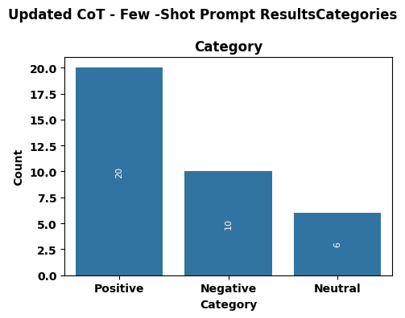
Few-Shot CoT Prompt Results
Plot illustrating distribution of Categories

Slide 59
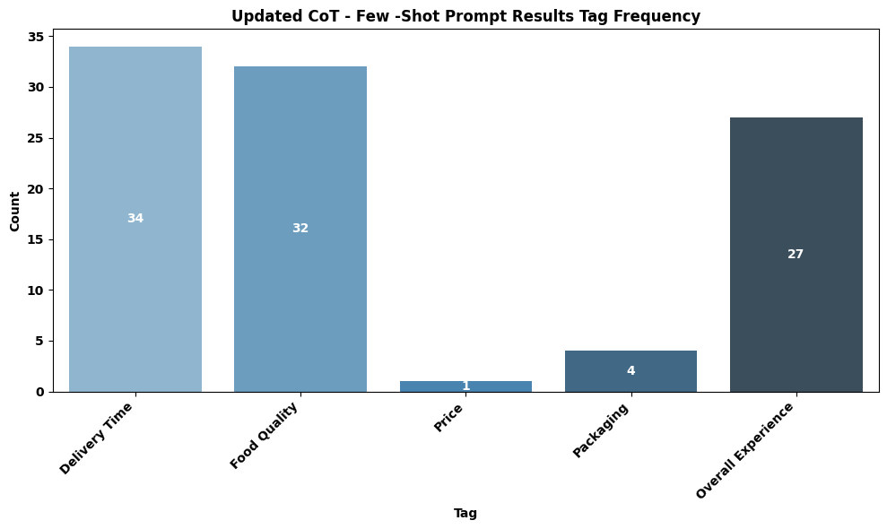
Few-Shot CoT Prompt Results
Plot illustrating distribution of Tags

Slide 60
Updated Few-Shot CoT Prompt
The preceding Few-Shot CoT Prompt was updated to include the following Classification and Tag definitions.
The model was run and produced a new set of results, outlined in the following slides.
CLASSIFICATION GUIDELINES:
Positive: Customer expresses satisfaction, praise, or intent to return
Negative: Customer expresses dissatisfaction, complaints, or intent to not return. If a review contains both positive/neutral and significant negative feedback (e.g., major delays, cold food, wrong order, poor value for money), classify as Negative.
Neutral: Mixed feedback where positive and negative aspects are balanced, or neither clearly positive nor negative.
TAGS (select ALL applicable from this list ONLY):
Delivery Time
Food Quality: Includes taste, temperature (if affecting quality), freshness, accuracy of order content (e.g., wrong dish, missing items).
Price
Packaging: Includes physical integrity of packaging, spillage, or incorrect items due to packing error.
Overall Experience: Apply when the customer explicitly states "experience," "service," "will/won't order again," or uses strong general rating language that clearly reflects their overall sentiment about the entire transaction (e.g., "very satisfied," "impressive," "always happy," "everything was perfect," "very pleased," "loved everything," "terrible meal").
***** Highlighted text indicates differences from Original Few-Shot CoT Prompt

Slide 61
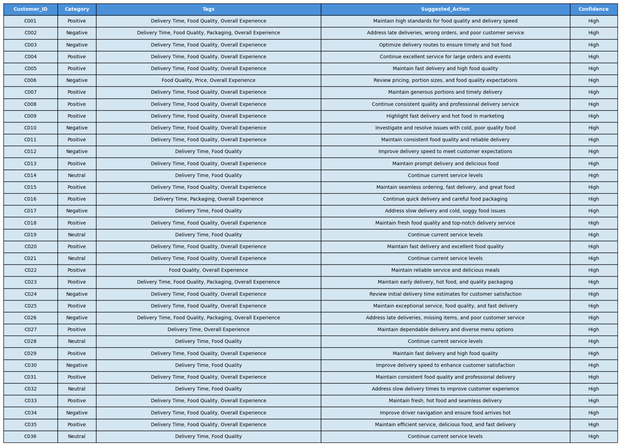
Updated Few-Shot CoT Prompt Results

Slide 62
Updatd Few-Shot CoT Prompt Results
Numerical Comparison Summary (Updated Few-Shot CoT Prompt, Original Tags, T=0.2 vs. Ground Truth):
1. Category Differences (vs. Ground Truth):
C011: My Positive vs. GT Neutral - 1 difference
Total Category Differences: 1
2. Tags Differences (vs. Ground Truth):
C002: My (Food Quality, Overall Experience) vs. GT (Packaging, Overall Experience) - 2 differences
C008: My (Delivery Time) vs. GT (no Delivery Time) - 1 difference
C009: My (no Overall Experience) vs. GT (Overall Experience) - 1 difference
C011: My (Delivery Time, no Overall Experience) vs. GT (no Delivery Time, Overall Experience) - 1 difference
C018: My (Delivery Time) vs. GT (no Delivery Time) - 1 difference
C026: My (Food Quality, Overall Experience) vs. GT (Packaging, Overall Experience) - 1 difference
C027: My (Delivery Time) vs. GT (no Delivery Time) - 1 difference
C031: My (Delivery Time) vs. GT (no Delivery Time) - 1 difference
C033: My (Delivery Time, no Overall Experience) vs. GT (no Delivery Time, Overall Experience) - 1 difference
Total Tags Differences: 10
3. Total Rows with at least one difference (Category or Tags): 9 out of 36 rows.

Slide 63
Updated Few-Shot CoT Prompt Results
Conclusion:
The updated Few-Shot CoT prompt shows a small improvement when compared against the Ground Truth Results dataset.
• Category alignment: Only 1 discrepancy (C011)
• Tag alignment: 10 discrepancies, a minor improvement
• Total rows with differences: 9 out of 36 rows, again a slight improvement
Few-shot examples combined with clearer guidelines significantly improved the model's performance. We saw better tag accuracy and very consistent sentiment categories, proving this approach is more effective.

Slide 64
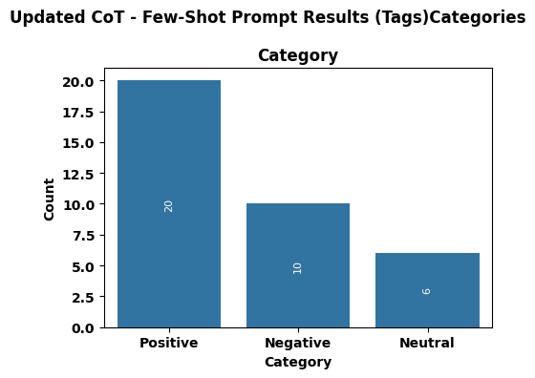
Updated Few-Shot CoT Prompt Results
Plot illustrating distribution of Categories

Slide 65
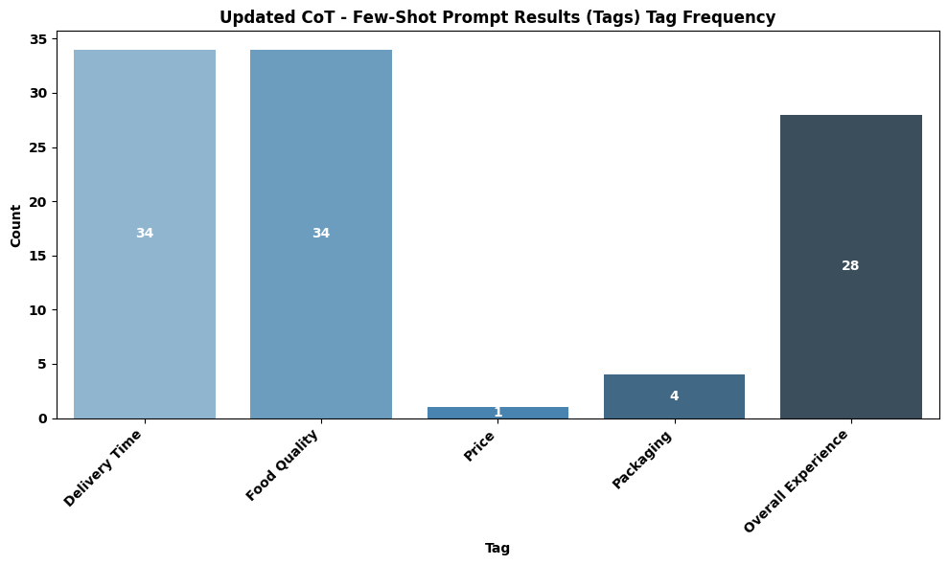
Updated Few-Shot CoT Prompt Results
Plot illustrating distribution of Tags

Slide 66
Few-Shot CoT Prompt Results
Numerical Comparison Summary (Updated Few-Shot Prompt, Original Tags, T=0.2 vs. Ground Truth):
1. Category Differences (vs. Ground Truth):
Total Category Differences: 0
2. Tags Differences (vs. Ground Truth):
Total Tags Differences: 10
3. Total Rows with at least one difference (Category or Tags): 8 out of 36 rows.
Conclusion:
The results for Few-Shot CoT prompt are exactly the same as those for Few-Shot CoT.

Slide 67
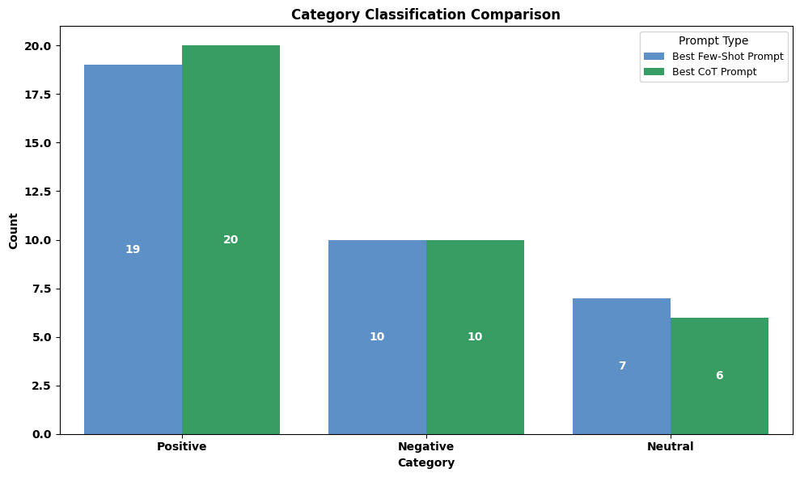
Best Performing Models Comparison
Plot comparing distribution of Category for best Few-Shot and Few-Shot CoT prompts.

Slide 68
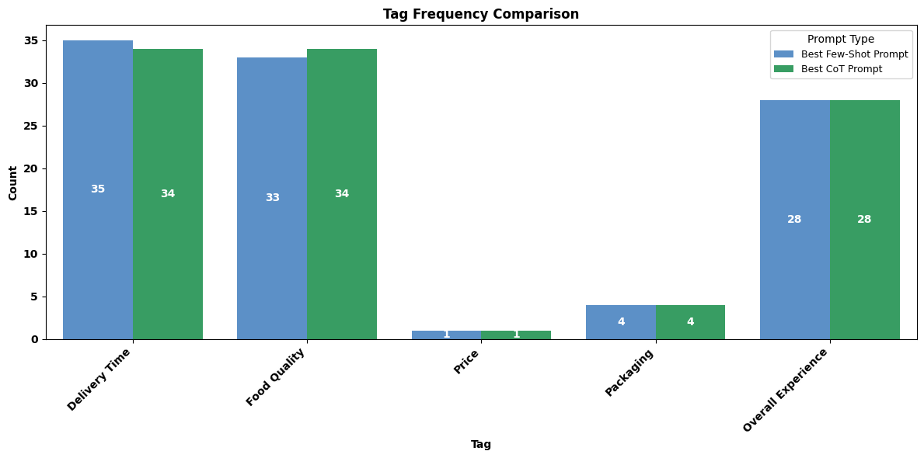
Best Performing Models Comparison
Plot comparing distribution of Tags for best Few-Shot and Few-Shot CoT prompts.

Slide 69
Best Performing Models Comparison
The "Best Few-Shot Prompt" achieved perfect accuracy (0 discrepancies) in both category and tag classification. The "Few-Shot CoT Prompt" was very close, with only 1 category and 10 tag discrepancies.
I found it surprising that the Few-Shot Prompt would beat out Few-Shot CoT in terms of classification accuracy
Possible Reasons for This?
Directness vs. Steps: The Few-Shot Prompt might have directly learned from examples without extra reasoning steps, leading to flawless results for this specific task.
Subtle Interpretation: While generally CoT helps, its explicit steps might have caused slight confusion in a few trickier cases compared to the example-driven Few-Shot Prompt.
Task Fit: For well-defined tasks with good examples, adding CoT might not always improve accuracy and can sometimes introduce minor deviations.
Sometimes keeping it simpler, lean and clean outperforms overthought/analyzed/complicated solutions
The perfect accuracy is an alarm bell for possible overfitting, which might result in worse performance of the Few-Shot Prompt model when applied to the entire dataset.
Next Steps?
Run both these “Best Performing” models against the entire dataset and compare the results.
Since this is unstructured data with no known/provided target label features, we’ll have to randomly manually select and spot-compare some data rows

Slide 70
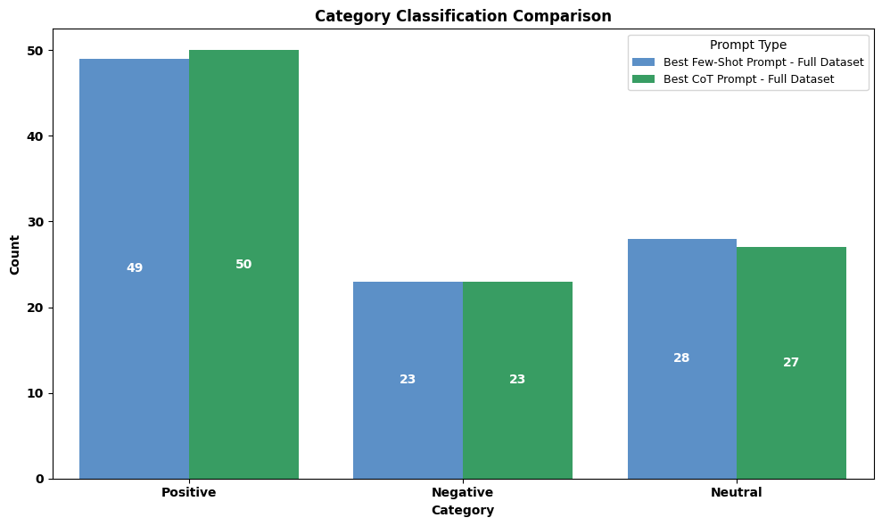
Best Performing Models Comparison (Full Dataset)
Plot comparing distribution of Category for best Few-Shot and Few-Shot CoT prompts. The models have a very similar Category frequency distribution.

Slide 71
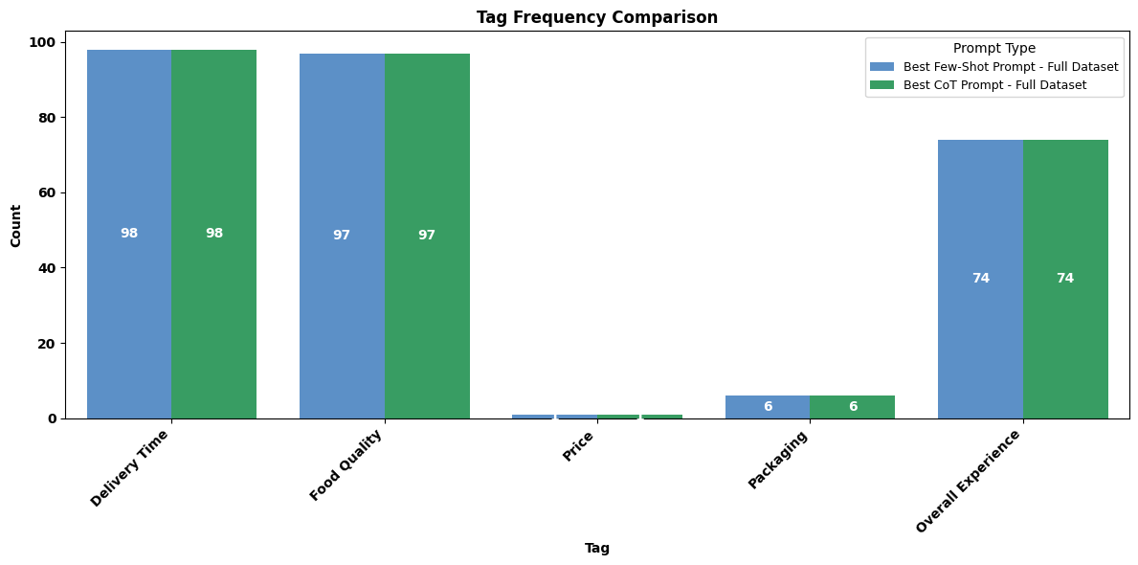
Best Performing Models Comparison (Full Dataset)
Plot comparing distribution of Tags for best Few-Shot and Few-Shot CoT prompts. The models have exactly the same Tag frequency distribution.

Slide 72
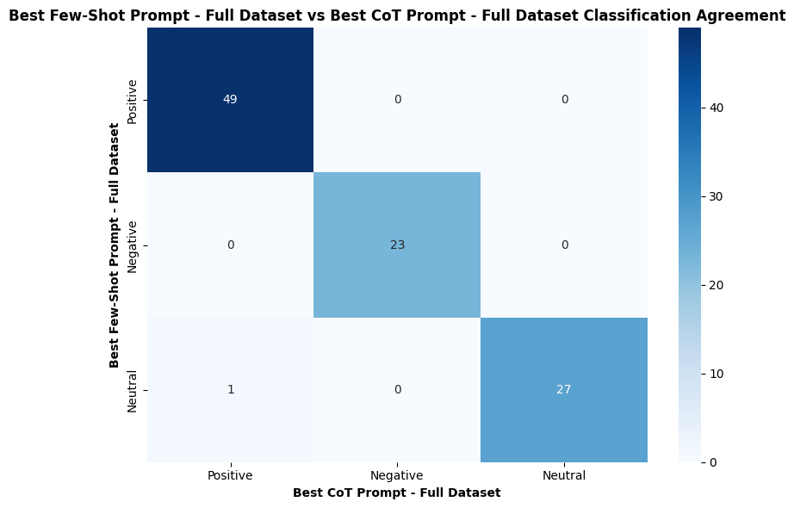
Best Performing Models – Category Comparison
Both prompt types agree on 99 out of 100 classifications, with only 1 review classified differently (Few-Shot: Neutral, CoT: Positive). This indicates both methods perform nearly identically on this dataset.

Slide 73
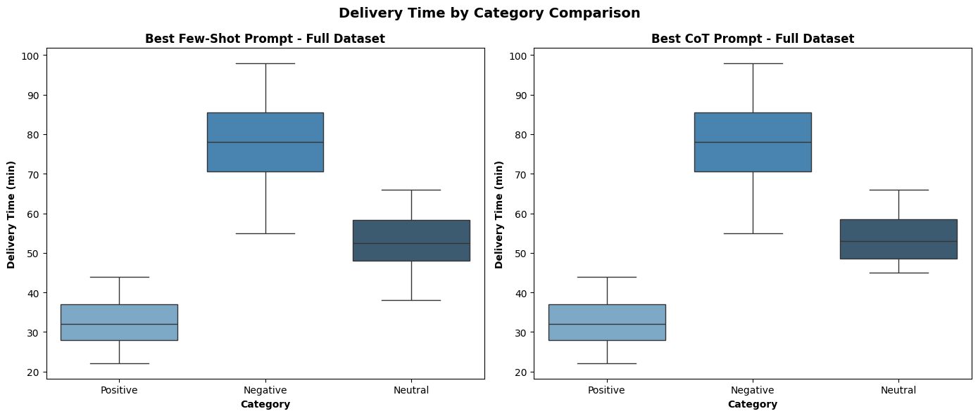
Best Performing Models – Category Comparison
Both prompt types show the same pattern: negative reviews have significantly longer delivery times (median ~78 min), while positive reviews have the shortest (median ~30 min). This confirms that delivery time is a strong driver of customer sentiment, and both prompts capture this relationship consistently.

Slide 74
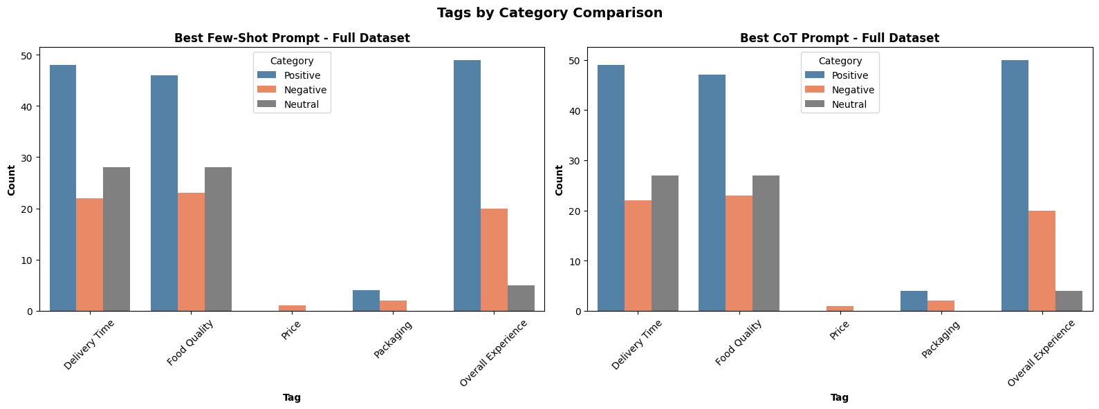
Best Performing Models – Category Comparison
Tag assignment in both plot times is almost identical, with Delivery Time, Food Quality, and Overall Experience being the most common across all sentiment categories. Price and Packaging are rarely tagged, suggesting these factors are mentioned infrequently in customer reviews.

Slide 75
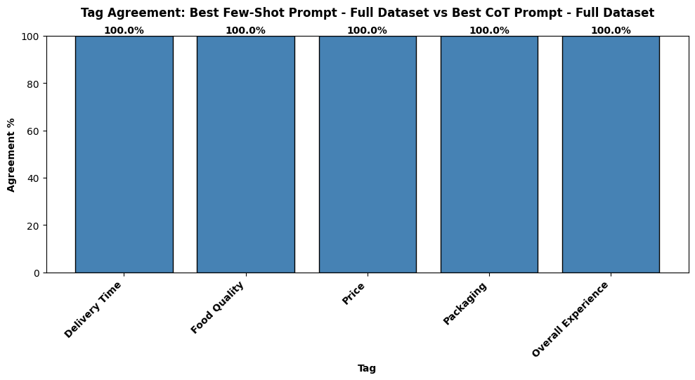
Best Performing Models – Tags Comparison
Both prompt types agree 100% on tag assignments across all five categories. This indicates that Few-Shot and CoT prompts identify the same themes in customer reviews with no variation.

Slide 76
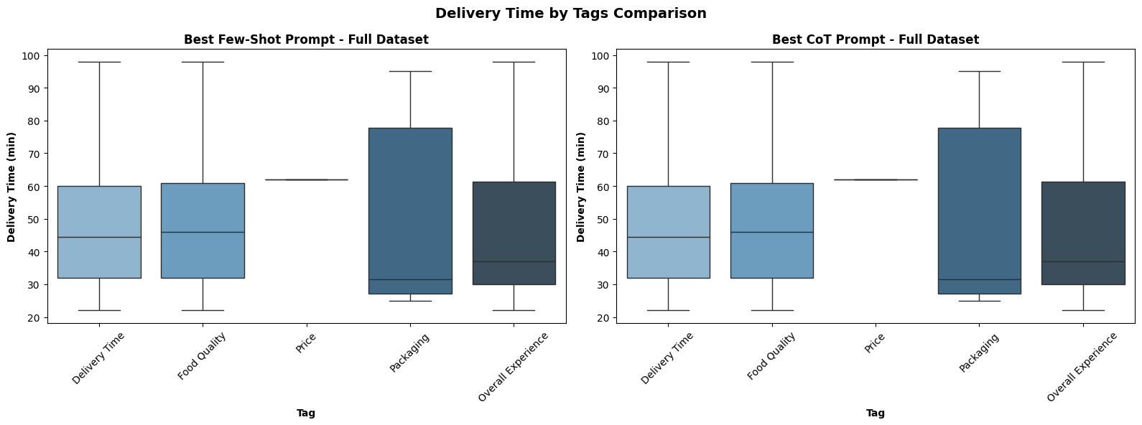
Best Performing Models – Tags Comparison
Both prompts show the same delivery time patterns across all tags. Packaging has the widest spread of delivery times, while Price was tagged in only a single review—indicating these factors are rarely the focus of customer feedback compared to Delivery Time, Food Quality, and Overall Experience.

Slide 77
Few-Shot ←→Few-Shot Cot Comparison Results
Additional Observations:
Category Consistency: Both models demonstrate very high consistency in category classification, with only a single disagreement (C011). This suggests that the few-shot examples and refined guidelines are highly effective in establishing a robust sentiment classification logic for both approaches.
Tag Discrepancies: For the tag differences, the "Best CoT Few-Shot Prompt" tends to include more tags than the "Best Few-Shot Prompt" (e.g., adding 'Delivery Time' or 'Food Quality' where the other did not). This suggests the CoT reasoning might be slightly more exhaustive in identifying all potentially applicable tags based on the review text. The simpler Few-Shot model is more selective, tagging only the main points.
"Overall Experience" Tag: Both models show strong agreement on the "Overall Experience" tag, indicating the guidelines for this tag are well-understood by both.
"Price" and "Packaging" Tags: These tags appear infrequently in the reviews, and both models show perfect agreement on their application in the observed differences.

Slide 78
Few-Shot ←→Few-Shot Cot Comparison Results
Numerical Comparison Summary (Updated Few-Shot Prompt, Original Tags, T=1.0 vs. Ground Truth):
1. Category Differences:
C011: CoT Few-Shot (Positive) vs. Few-Shot (Neutral) - 1 difference
Total Category Differences: 1
2. Tags Differences (vs. Ground Truth):
C008: CoT Few-Shot (Delivery Time, Food Quality, Overall Experience)
vs. Few-Shot (Food Quality, Overall Experience) - 1 difference (CoT added 'Delivery Time')
C009: CoT Few-Shot (Delivery Time, Food Quality, Overall Experience)
vs. Few-Shot (Delivery Time, Overall Experience) - 1 difference (CoT added 'Food Quality’)
C018: CoT Few-Shot (Delivery Time, Food Quality, Overall Experience)
vs. Few-Shot (Food Quality, Overall Experience) - 1 difference (CoT added 'Delivery Time')
C031: CoT Few-Shot (Delivery Time, Food Quality, Overall Experience)
vs. Few-Shot (Food Quality, Overall Experience) - 1 difference (CoT added 'Delivery Time')
C033: CoT Few-Shot (Delivery Time, Food Quality, Overall Experience)
vs. Few-Shot (Food Quality, Overall Experience) - 1 difference (CoT added 'Delivery Time')
Total Tags Differences: 20
3. Total Rows with at least one difference (Category or Tags): 6 out of 100 rows.

Slide 79
Few-Shot ←→Few-Shot Cot Comparison Results
General Summary:
It is important to remember that we are working on a small manufactured sample dataset that isn’t really representative of real-world data (or maybe it is?); regardless we are basing all our conclusions and insights on this small cultivated dataset.
Both the "Best CoT Few-Shot Prompt" and the "Best Few-Shot Prompt" perform exceptionally well on this dataset, demonstrating near-perfect alignment in category classification. The "Best Few-Shot Prompt" achieves a slightly higher overall alignment with the Ground Truth (0 discrepancies vs. 6 for CoT Few-Shot), particularly in tag selection.
The minor differences in tagging suggest that while CoT reasoning can lead to a more comprehensive identification of aspects, the simpler Few-Shot approach, when perfectly tuned with examples, can achieve slightly more precise or parsimonious tag assignments that align perfectly with the Ground Truth's specific annotation philosophy. For this particular task, the added complexity of explicit CoT steps did not translate into noticeable performance improvements over a well-optimized Few-Shot approach.

Slide 80
Few-Shot ←→Few-Shot Cot Comparison Results
Conclusion:
The Zero-Shot CoT analysis, consistent with other Zero-Shot attempts, confirms that explicit, refined textual guidelines and few-shot examples are crucial for achieving high alignment with specific annotation logic.
Few-Shot with clear examples works better than step-by-step reasoning for rule-based labelling. A few well constructed examples go further in improving the model than explaining it’s reasoning.
CoT added more complexity, but not necessarily better results. More steps don’t necessarily mean better results.
Prompt Model performance improvements through tighter defined prompt structures far outweigh benefits of temperature adjustment.
Subsequent runs with tighter Temperature settings produced the same results.
Observed Inconsistent Results – rerunning same prompt with same input data, temperature and commands does not produce consistent results across runs. This was mainly with running CoT prompts.

Slide 81
Few-Shot ←→Few-Shot Cot Comparison Results
Final Recommendation:
The final recommendation is to use Few-Shot Prompt over Chain-of-Thought prompts.
It gives more consistent labels.
Few-Shot followed the labeling rules more closely and avoided extra, unnecessary tags.
It’s easier to maintain.
You can change or fix behavior by updating examples instead of rewriting reasoning steps.
It’s faster and cheaper.
Few-Shot prompts are shorter and don’t require extra reasoning, which reduces cost and response time.
It’s easier to debug.
When something looks wrong, you can compare the output directly to the examples.
It matched the ground truth best.
In this analysis, Few-Shot aligned most closely with the benchmark labels.

Slide 82
Additional Observations
1. Chain-of-Thought Increased Output Variability
When using CoT prompts, repeated executions with the same input and settings occasionally produced different outputs. This made it difficult to tract consistent results at times.
2. Issues with consistent formatted output results.
Despite providing concise/exact instructions, Gemini still occasionally produced improperly formatted CSV output
3. Incorrect Prompt Parsing.
Gemini would sometimes indicate there were prompt structure/definition errors when there in fact were none.
4. Gemini is still very much a work in progress platform
Given the instabilities and inconsistancies I experienced Gemini is still an AI platform in development.

Slide 83
APPENDIX

Slide 84
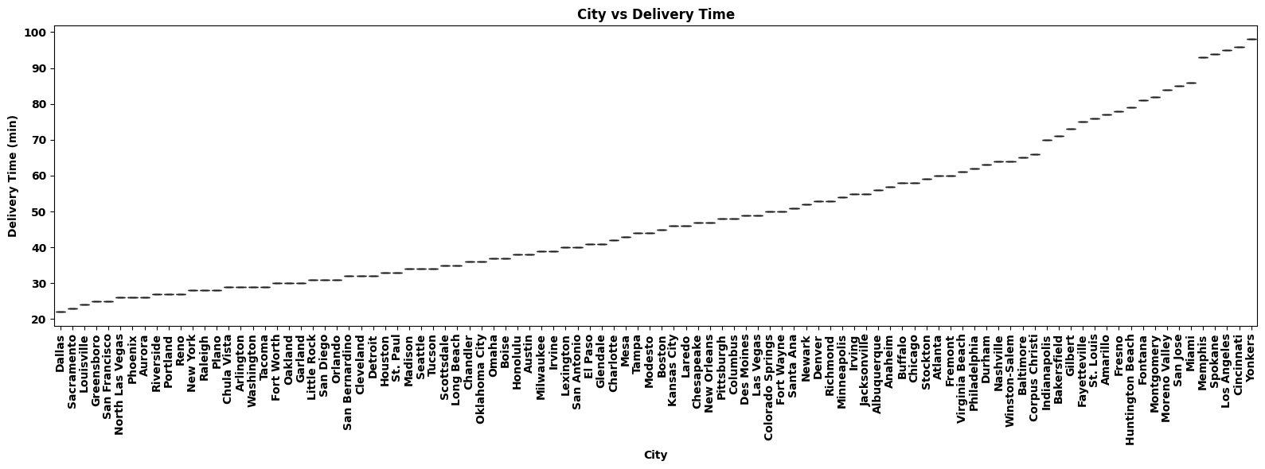
Additional EDA – Feature Distributions & Relationships
Delivery times range from 22 minutes (Dallas) to 98 minutes (Yonkers) across the dataset. This is not a meaningful plot, since there is only one review per city. More data per city would produce more meaningful patterns

Slide 85
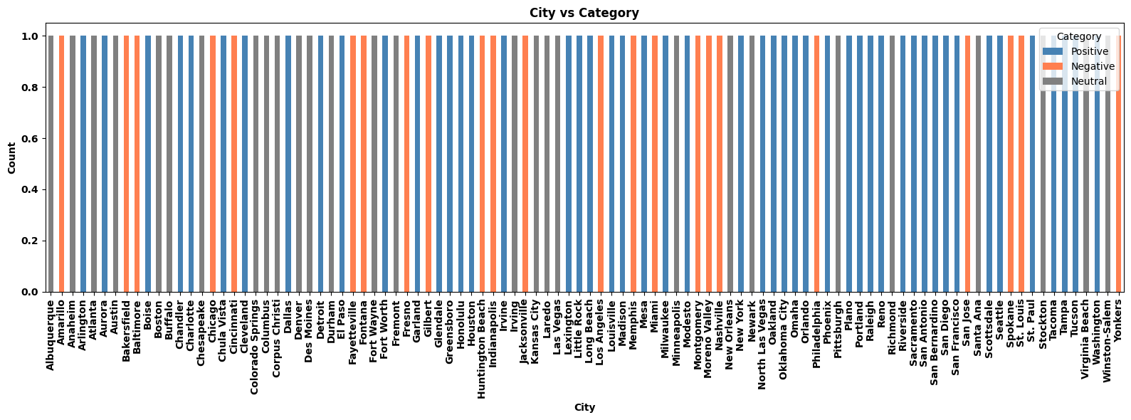
Additional EDA – Feature Distributions & Relationships
Each city has exactly one review, with sentiment evenly distributed across Positive (blue), Negative (coral), and Neutral (gray) This is not a meaningful plot, since there is only one data point per city. More data per city would produce more meaningful patterns

Slide 86
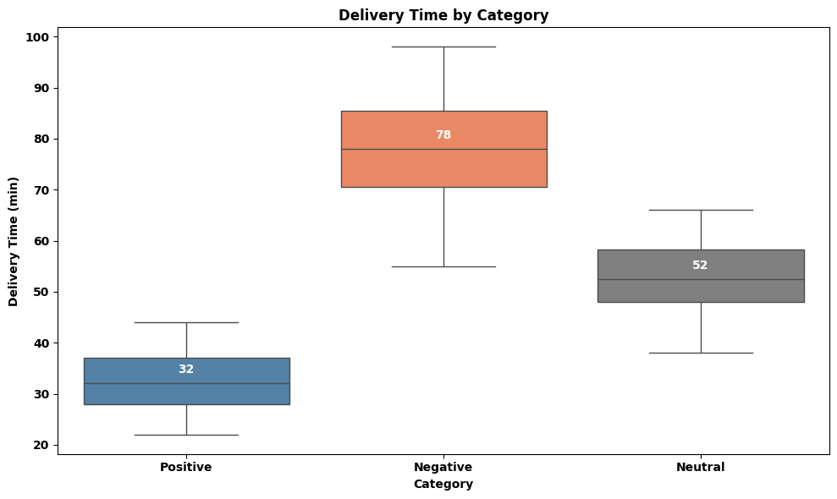
Additional EDA – Feature Distributions & Relationships
Negative reviews have significantly longer delivery times (median 78 min) compared to Positive reviews (median 32 min), with Neutral reviews falling in between (median 52 min). Delivery time is a strong driver of customer sentiment; longer waits lead to negative feedback.

Slide 87
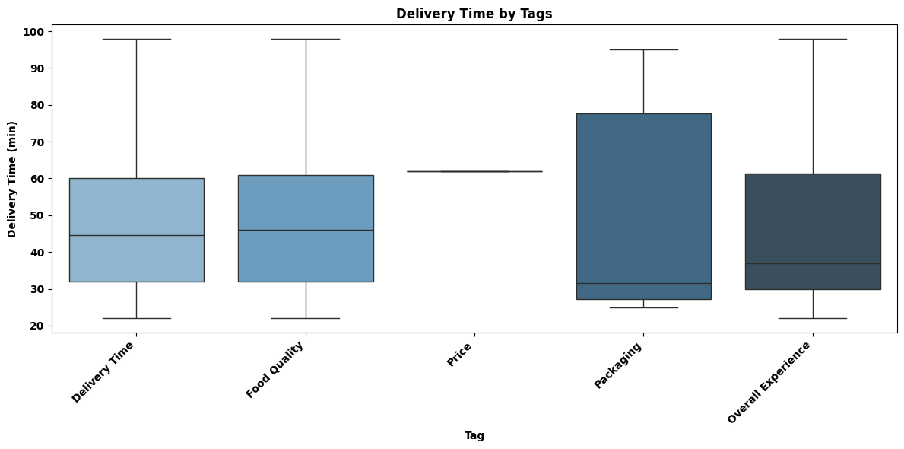
Additional EDA – Feature Distributions & Relationships
Delivery Time, Food Quality, and Overall Experience tags show similar delivery time distributions, indicating these are mentioned across all delivery speeds. Price was tagged in only one review (~62 min), while Packaging shows a wide range with a higher median, suggesting packaging issues are more noticeable during longer deliveries (People more critical when they are already annoyed about a late delivery).

Slide 88
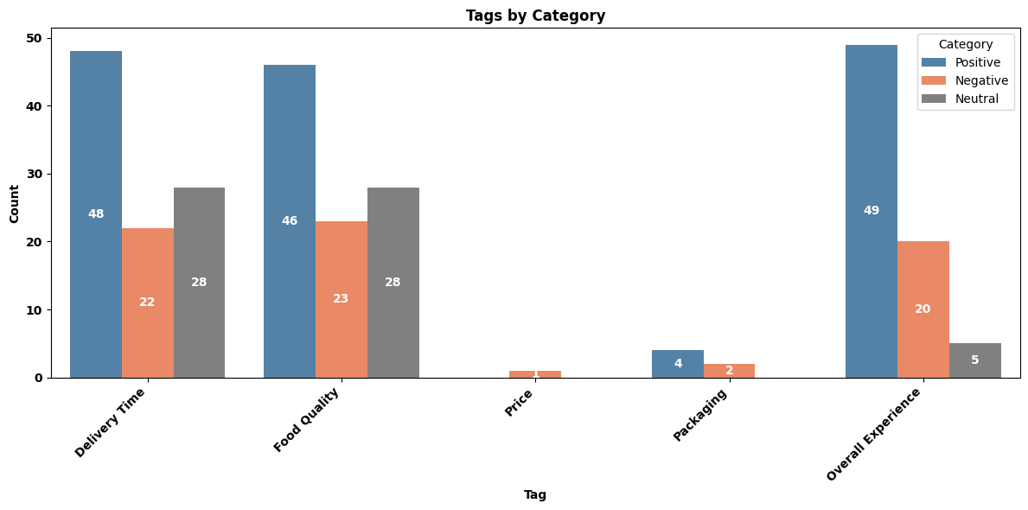
Additional EDA – Feature Distributions & Relationships
Delivery Time, Food Quality, and Overall Experience are the most frequently tagged, with Positive reviews having the highest counts across all three. Price and Packaging are rarely tagged, with only 1 and 6 total mentions respectively

Slide 89
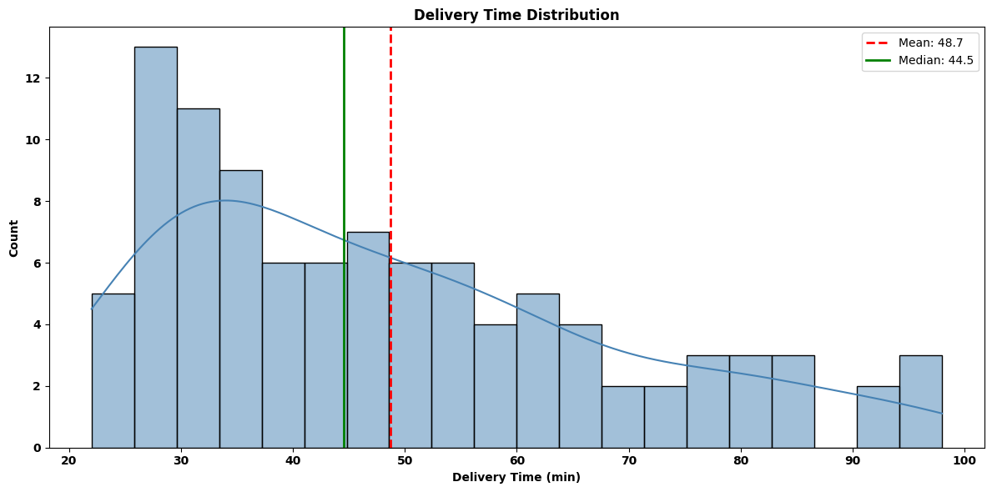
Additional EDA – Feature Distributions & Relationships
Delivery times are right-skewed with most orders arriving between 25-40 minutes, and a median of 44.5 minutes. The mean (48.7 min) is higher than the median, indicating some longer deliveries are pulling the average up.

Slide 90
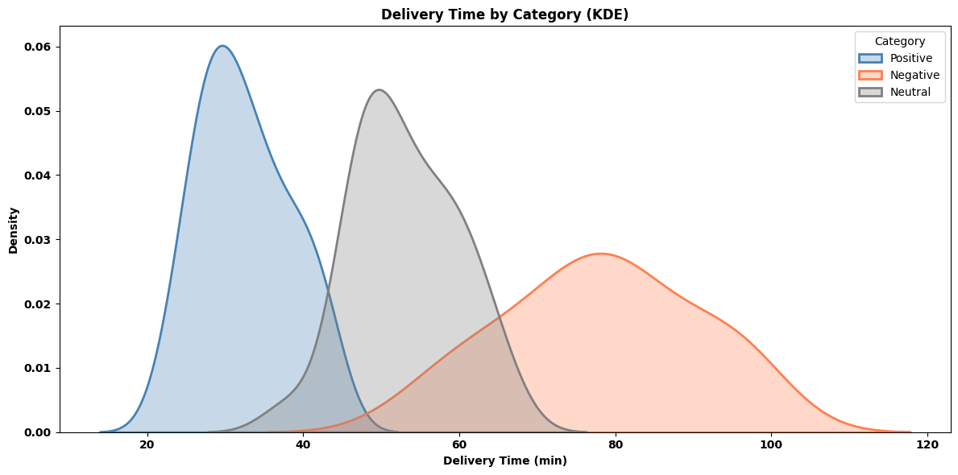
Additional EDA – Feature Distributions & Relationships
The three sentiment categories show clearly separated delivery time distributions—Positive reviews peak around 30 minutes, Neutral around 50 minutes, and Negative around 75-80 minutes. This demonstrates a strong relationship between delivery time and customer sentiment, with minimal overlap between categories

Slide 91
Entire Few-Shot Prompt with Zero (0) Discrepancies
The following is the the Few-Shot Prompt definition that produced results that had zero discrepancies with the Ground Truth dataset. This is the best performing prompt model that I chose.
Few-Shot Prompt Template:
ROLE: You are a customer feedback analyst for a food delivery service.
TASK: Analyze the uploaded customer reviews and provide structured sentiment analysis.
Use Temperature=0.2
CLASSIFICATION GUIDELINES:
Positive: Customer expresses satisfaction, praise, or intent to return Negative: Customer expresses dissatisfaction, complaints, or intent to not return. If a review contains both positive/neutral and significant negative feedback (e.g., major delays, cold food, wrong order, poor value for money), classify as Negative. Neutral: Mixed feedback where positive and negative aspects are balanced, or neither clearly positive nor negative. TAGS (select ALL applicable from this list ONLY):
Delivery Time
Food Quality: Includes taste, temperature (if affecting quality), freshness, accuracy of order content (e.g., wrong dish, missing items).
Price
Packaging: Includes physical integrity of packaging, spillage, or incorrect items due to packing error.
Overall Experience: Apply when the customer explicitly states "experience," "service," "will/won't order again," or uses strong general rating language that clearly reflects their overall sentiment about the entire transaction (e.g., "very satisfied," "impressive," "always happy," "everything was perfect," "very pleased," "loved everything," "terrible meal").

Slide 92
Entire Few-Shot Prompt with Zero (0) Discrepancies
OUTPUT REQUIREMENTS
Category: Classify as exactly one of: Positive, Negative, or Neutral
Tags: Select ALL applicable tags from the list above.
Suggested_Action: Provide ONE specific, actionable business recommendation (10 words max)
Confidence: High / Medium / Low
OUTPUT FORMAT: Return results as CSV format only. No explanations, no extra text. Use these exact headers: Customer_ID, Category, Tags, Suggested_Action, Confidence
Rules:
Wrap Tags in quotes if multiple: "Delivery Time, Food Quality"
Wrap Suggested_Action in quotes
Suggested_Action: 10 words max, no commas
One row per customer

Slide 93
Entire Few-Shot Prompt with Zero (0) Discrepancies
EXAMPLES: Review: "The food arrived 15 minutes late, which was annoying, but the pad thai was absolutely delicious and still hot. The driver was also very apologetic." Category: Neutral Confidence: Medium Tags: Delivery Time, Food Quality, Overall Experience Suggested Action: Investigate delivery delay, maintain food quality. Review: "I ordered the large family meal, and the portion sizes were surprisingly small for the price. The chicken was a bit dry, but the sides were fresh. Overall, it felt like a rip-off." Category: Negative Confidence: High Tags: Food Quality, Price, Overall Experience Suggested Action: Review portion sizes and chicken preparation for value. Review: "My smoothie spilled all over the bag because the lid wasn't properly sealed. The delivery was fast, but half my order was a sticky mess. Very disappointed." Category: Negative Confidence: High Tags: Delivery Time, Packaging, Overall Experience Suggested Action: Improve packaging seal quality for liquid items. Review: "The vegetarian burrito was exactly as described and tasted good. Delivery was on time. It was a perfectly fine meal, nothing to rave about." Category: Neutral Confidence: Medium Tags: Delivery Time, Food Quality Suggested Action: Seek feedback to elevate "fine" to "memorable." Review: "This is my go-to service. The sushi is always fresh, and the drivers are consistently friendly. I've never had a bad experience, which is why I keep coming back." Category: Positive Confidence: High Tags: Delivery Time, Food Quality, Overall Experience Suggested Action: Highlight consistent quality and reliable service in marketing.

